Slide 1
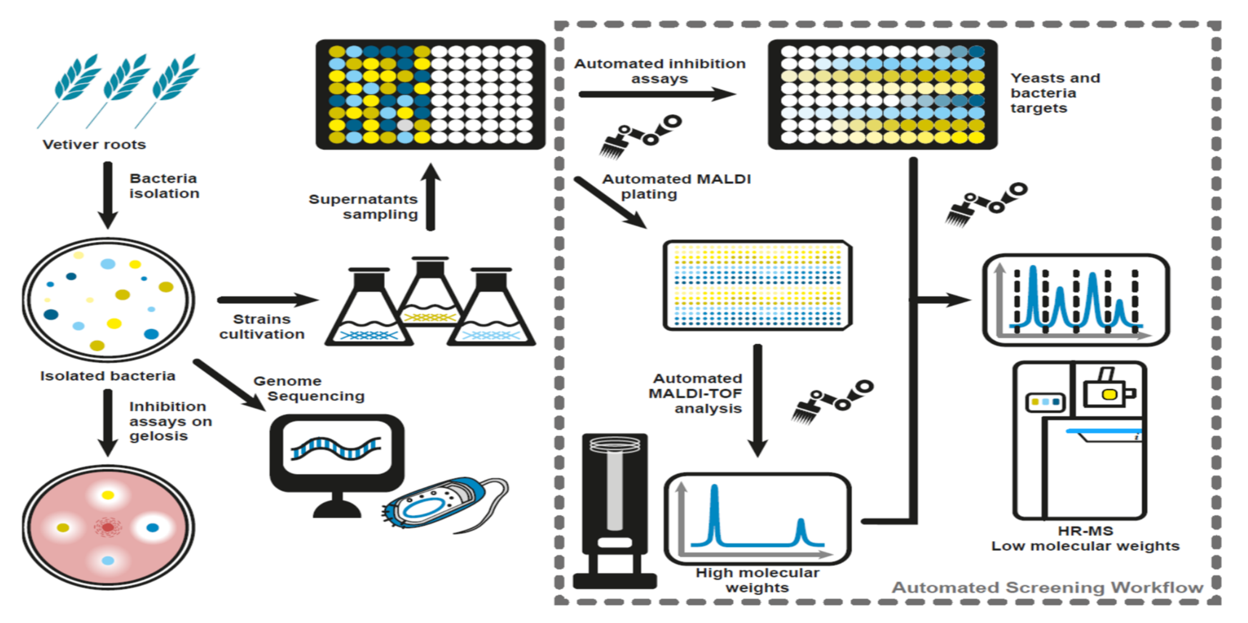
ISOLATION AND SCREENING OF MICROBES DEGRADING POLLUTANTS
JIGNESH PATHAK
Teaching Assistant
PSSHDA, KADI

Slide 2
Introduction
The process of biodegradation, defined as the use of microorganisms to eliminate pollutants is an evolving method for the removal and degradation of many environmental pollutants including the products of petroleum industry. Moreover, biodegradation is believed to be noninvasive and comparatively cost effective.
Biodegradation by natural populations of microorganismsrepresents one of the major mechanisms by which petroleum and other hydrocarbon pollutants can be removed from the environment and is relatively cheaper than the other degradation technologies.

Slide 3
BIODEGRADATION
Biodegradation is the breakdown of complex toxic organic contaminants to non-toxic and
simpler elements by microbial activity. These contaminants can be considered as the microbial
food source or substrate. Biodegradation of any organic compound is a series of biological
degradation steps or a pathway that ultimately results in the oxidation of the parental compound
that often results in the generation of energy. Microorganisms have the capability of degrading
all naturally occurring compounds.

Slide 4
Isolation and screening of microbes capable of degrading pollutants are crucial steps in bioremediation and environmental cleanup processes. Selective and enrichment cultivation techniques are commonly employed to isolate and identify these pollutant-degrading microorganisms from complex environmental samples. Here's an overview of these techniques:

Slide 5
Selective Cultivation Techniques:
Selective cultivation techniques are designed to promote the growth of specific microorganisms while inhibiting the growth of others. They involve the use of specific growth media or conditions that favor the target pollutant-degrading microbes. Some common selective techniques include:
Enriched Media: Using media enriched with the pollutant of interest or its derivatives to encourage the growth of microorganisms capable of utilizing the pollutant as a carbon or energy source.
Inhibitory Substances: Adding substances that inhibit the growth of non-target organisms, allowing the target pollutant degraders to dominate the culture.
Temperature or pH Conditions: Setting specific temperature or pH conditions that are optimal for the growth of the desired microorganisms and detrimental to others.
Dilution Techniques: Serial dilutions of environmental samples are made to reduce microbial diversity and favor the growth of rare pollutant degraders.

Slide 6
Enrichment Cultivation Techniques:
Enrichment techniques involve repeated transfers of the environmental sample into fresh media containing the target pollutant. These techniques are useful for increasing the abundance of pollutant-degrading microorganisms and for adapting them to grow under laboratory conditions. Common enrichment techniques include:
Repeated Subculturing: Regularly transferring a portion of the culture from one medium to a fresh one containing the pollutant. This process enriches the population of pollutant degraders over time.
Continuous Culture Systems: Employing continuous culture systems where a constant flow of nutrients and pollutant is provided, and microbial growth is maintained in a steady state.
Bioreactors: Using bioreactors with controlled environmental conditions to simulate natural habitats and facilitate the growth of pollutant-degrading microorganisms.
Bioaugmentation: Introducing known pollutant-degrading microorganisms into the environmental sample to enhance their abundance and activity.
After employing selective and enrichment cultivation techniques, the enriched cultures can be further characterized using various molecular and biochemical methods to identify the specific pollutant-degrading microorganisms present. Once identified, these microbes can be utilized in bioremediation efforts to tackle pollution in contaminated environments effectively.

Slide 7
Isolating pollutant degraders is an essential step in environmental bioremediation, which is the use of living organisms to clean up or reduce pollution in soil, water, and air. Here's a general overview of the process:
1. Site Assessment
2. Sample Collection
3. Enrichment Culture:
7. Testing in the Field:
4. Serial Dilution:
5. Screening
6. Characterization

Slide 8
Conti..
1. Site Assessment: Before isolating pollutant degraders, a thorough assessment of the contaminated site is conducted. This includes understanding the type and extent of pollutants present, as well as the environmental conditions (e.g., pH, temperature, moisture) that could affect the degradation process.
2. Sample Collection: Soil, water, or other environmental samples are collected from the contaminated site. These samples will contain a wide range of microorganisms, including potential pollutant degraders.
3. Enrichment Culture: In the laboratory, the collected samples are placed in a growth medium that contains the pollutant of interest as the sole carbon source. This creates a selective environment that encourages the growth of microorganisms capable of degrading the pollutant.

Slide 9
Conti..
4. Serial Dilution: To isolate individual pollutant degraders, serial dilution is performed. This involves diluting the enriched culture and spreading it onto agar plates. The goal is to obtain isolated colonies of microorganisms.
5. Screening: The isolated colonies are then screened for their ability to degrade the specific pollutant of interest. Various biochemical and molecular techniques are used to identify the potential degraders.
6. Characterization: Once potential pollutant degraders are identified, they are further characterized to understand their degradation capabilities, environmental requirements, and potential application in bioremediation.
7. Testing in the Field: Finally, the isolated pollutant degraders are tested in the actual contaminated site (in situ) or in a controlled environment mimicking the site conditions (ex situ) to assess their effectiveness in degrading the pollutant and their overall impact on the ecosystem.

Slide 10
THANK YOU

