Slide 1

Pramukh Swami Science & H.D.Patel Arts College, Kadi
Prof. Chetan Patel
B.Sc. Sem: VI
TOPIC – Transistor as an Amplifier

Slide 2
Contents
Introduction
What is Transistor?
Transistor Symbols
Applications of Transistor
Working of Transistor as an Amplifier
How Transistor Works as an Amplifier?
Examples
Calculations
Reference
Conclusion

Slide 3
Introduction
* The goal of this presentation is to learn basics of Transistor as an Amplifier, its working, method, calculations etc.
Well, I have chosen this topic to enhance my concepts of Transistor and boost my technical skills.
The following presentation should be a good start for all of you too. So, let see upcoming slides for more details.

Slide 4

What is Transistor?
A transistor is a semiconductor device used to amplify or switch electronic signals and electrical power. It is composed of semiconductor material usually with at least three terminals for connection to an external circuit.

Slide 5
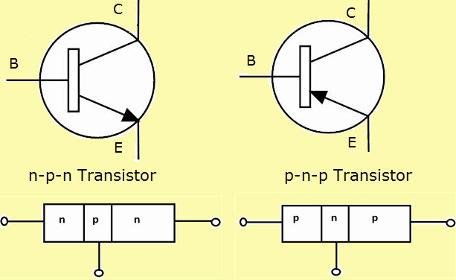
Transistor Symbol

Slide 6
Applications of TRANSISTOR
Amplification
Switching

Slide 7
Working of Transistor as an Amplifier
Transistor can operate in three different regions viz., cutoff, active and saturation.
Transistors are fully-off in cut-off region while fully-on when operating in saturation region.
However, while they operate in active region, they act as amplifiers i.e. they can be used to increase the strength of the input signal without altering it significantly.

Slide 8
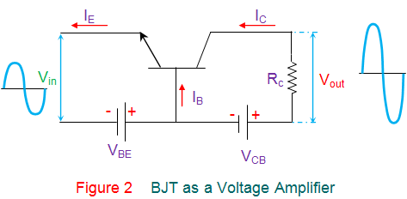


How Transistor Works as an Amplifier

Slide 9
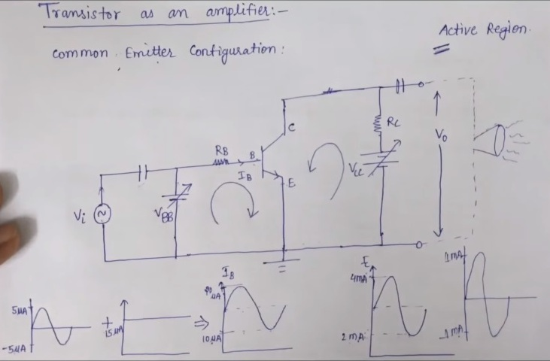

Slide 10
Calculations
∆IB=(20-10) uA =10uA
∆Ic=(4-2) mA =2mA
Current Amplification Factor, BAC= ∆Ic/ ∆IB=200
Voltage Amplification , Av= ∆Vo/ ∆Vi
Applying KVL in input and output loop, ∆Vi= ∆VBB and ∆Vo=-IcRc

Slide 11
Calculations[Cont.]
Therefore, Av=-BACRc/RB (‘-’ sign indicates 180 phase shift)
Hence, we can change value of Av by changing Rc and RB
Power Amplification, Ap=Voltage Amplification X Current Amplification=-BAC^2 x Rc/RB
We use capacitor here to remove DC currents and only allow AC to flow

Slide 12
Reference
* Content Source
Electrical4U.com
* Image Source
Google Images
Youtube.com

Slide 13
Conclusion
We are now at the end of the presentation. I have tried my best to deliver the content in easy manner. Hope your concept regarding transistor as an amplifier are more clear now and enjoyed my presentation.
Good luck and have a great day ahead!

Slide 14
Thank You

