Slide 1

1
APPLICATIONS
OF INTEGRATION
Prepared By
Prof. D. G. Patel,
Mathematics Department,
Pramukh Swami Science College, Kadi.

Slide 2
APPLICATIONS OF INTEGRATION
In previous discussion, we looked at some applications of integrals:
  Areas
  Volumes

Slide 3
APPLICATIONS OF INTEGRATION
Here, we explore:
  Some of the many other geometric applications
  of integration—such as the length of a curve and
  the area of a surface
  Quantities of interest in physics, engineering,
  biology, economics, and statistics

Slide 4
APPLICATIONS OF INTEGRATION
For instance, we will investigate:
  Center of gravity of a plate
  Force exerted by water pressure on a dam
  Flow of blood from the human heart
  Average time spent on hold during a customer
  support telephone call

Slide 5
APPLICATIONS OF INTEGRATION
Arc Length
In this section, we will learn about:
Arc length and its function.

Slide 6
ARC LENGTH
What do we mean by
the length of a curve?

Slide 7
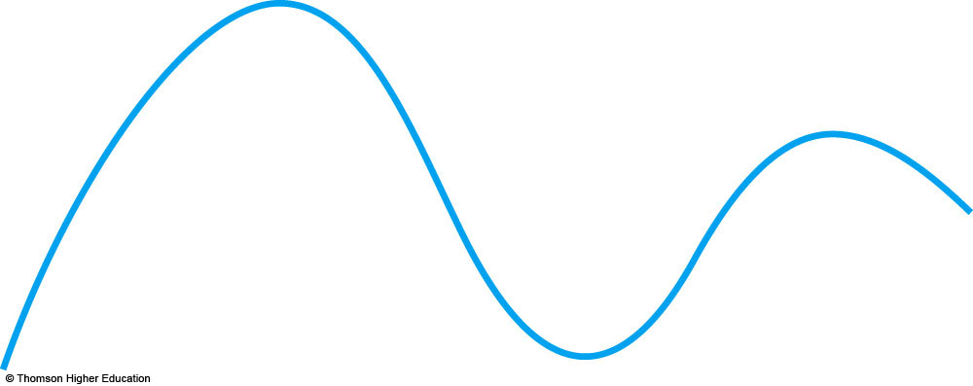
ARC LENGTH
We might think of fitting a piece of string
to the curve here and then measuring
the string against a ruler.

Slide 8
ARC LENGTH
However, that might be difficult
to do with much accuracy if we have
a complicated curve.

Slide 9
ARC LENGTH
We need a precise definition for the length
of an arc of a curve—in the same spirit as
the definitions we developed for the concepts of area and volume.

Slide 10
POLYGON
If the curve is a polygon, we can easily find its length.
  We just add the lengths of the line segments
  that form the polygon.
  We can use the distance formula to find the distance between the endpoints of each segment.

Slide 11
ARC LENGTH
We are going to define the length of
a general curve in the following way.
  First, we approximate it by a polygon.
  Then, we take a limit as the number of segments
  of the polygon is increased.

Slide 12
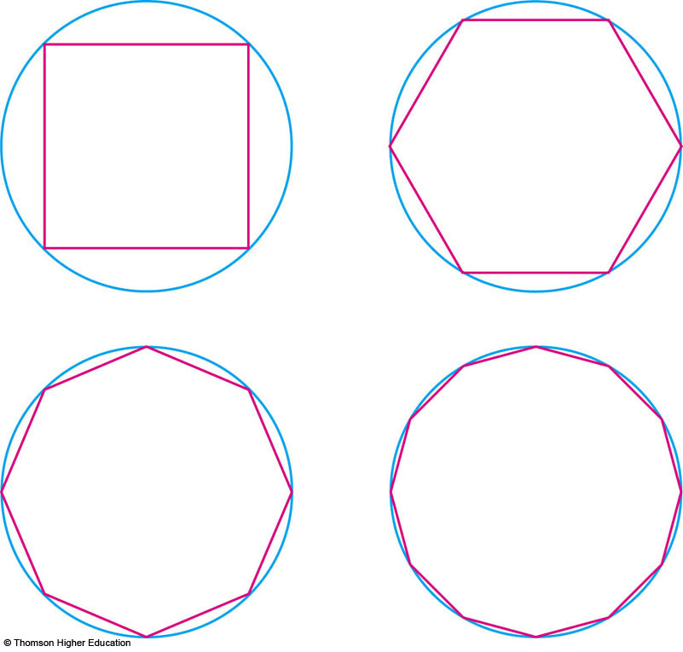
ARC LENGTH
This process is familiar for the case of a circle, where the circumference is the limit of lengths of inscribed polygons.

Slide 13
ARC LENGTH
Now, suppose that a curve C is
defined by the equation y = f(x),
where f is continuous and a ≤ x ≤ b.

Slide 14
ARC LENGTH
We obtain a polygonal approximation to C
by dividing the interval [a, b] into n subintervals with endpoints x₀, x₁, . . . , x_{n}
and equal width Δx.

Slide 15
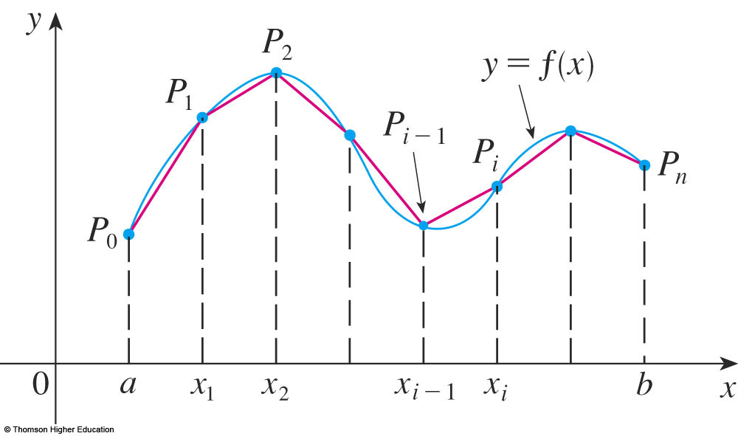
ARC LENGTH
If y_{i} = f(x_{i}), then the point P_{i} (x_{i}, y_{i}) lies on C
and the polygon with vertices P_{o}, P₁, …, P_{n},
is an approximation to C.

Slide 16
ARC LENGTH
The length L of C is approximately the length of this polygon and the approximation gets better as we let n increase, as in the next figure.

Slide 17
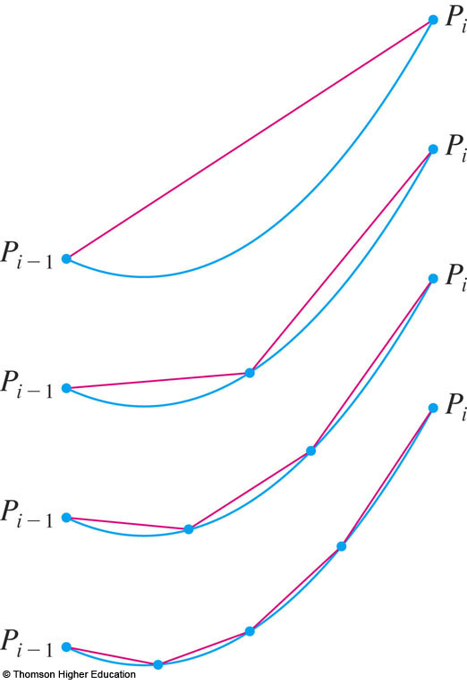
ARC LENGTH
Here, the arc of
the curve between
P_{i–1} and P_{i} has been magnified and approximations
with successively smaller values of Δx are shown.

Slide 18
ARC LENGTH
Definition 1
Thus, we define the length L of the curve C with equation y = f(x), a ≤ x ≤ b, as the limit
of the lengths of these inscribed polygons
(if the limit exists):

Slide 19
ARC LENGTH
Notice that the procedure for defining arc length is very similar to the procedure
we used for defining area and volume.
  First, we divided the curve into a large number
  of small parts.
  Then, we found the approximate lengths
  of the small parts and added them.
  Finally, we took the limit as n → ∞.

Slide 20
ARC LENGTH
The definition of arc length given by Equation 1 is not very convenient for computational purposes.
  However, we can derive an integral formula for L
  in the case where f has a continuous derivative.

Slide 21
SMOOTH FUNCTION
Such a function f is called smooth because a small change in x produces a small change in f’(x).

Slide 22
SMOOTH FUNCTION
If we let Δy_{i} = y_{i} – y_{i–1}, then

Slide 23
SMOOTH FUNCTION
By applying the Mean Value Theorem to f
on the interval [x_{i–1}, x_{i}], we find that there is
a number x_{i}* between x_{i–1} and x_{i} such that
that is,

Slide 24
SMOOTH FUNCTION
Thus, we have:

Slide 25
SMOOTH FUNCTION
Therefore, by Definition 1,

Slide 26
SMOOTH FUNCTION
We recognize this expression as being
equal to
by the definition of a definite integral.
  This integral exists because the function
  is continuous.

Slide 27
SMOOTH FUNCTION
Therefore, we have
proved the following
theorem.

Slide 28
ARC LENGTH FORMULA
Formula 2
If f’ is continuous on [a, b], then the length
of the curve y = f(x), a ≤ x ≤ b is:

Slide 29
ARC LENGTH FORMULA
Equation 3
If we use Leibniz notation for derivatives, we can write the arc length formula as:

Slide 30
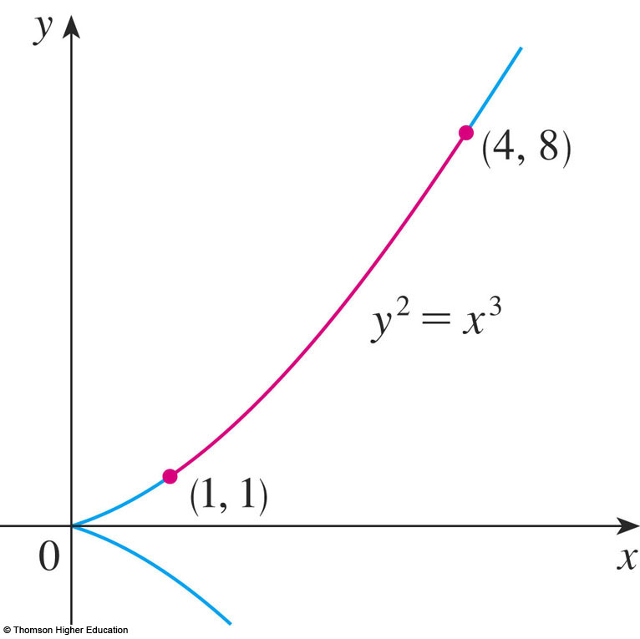
ARC LENGTH
Example 1
Find the length of the arc of the semicubical parabola y² = x³ between the points (1, 1)
and (4, 8).

Slide 31
ARC LENGTH
Example 1
For the top half of the curve,
we have:

Slide 32
ARC LENGTH
Example 1
Thus, the arc length formula gives:

Slide 33
ARC LENGTH
Example 1
If we substitute u = 1 + (9/4)x,
then du = (9/4) dx.
When x = 1, u = 13/4.
When x = 4, u = 10.

Slide 34
ARC LENGTH
Example 1
Therefore,

Slide 35
ARC LENGTH
Formula 4
If a curve has the equation x = g(y), c ≤ y ≤ d, and g’(y) is continuous, then by interchanging the roles of x and y in Formula 2 or
Equation 3, we obtain its length as:

Slide 36
ARC LENGTH
Example 2
Find the length of the arc of
the parabola y² = x from (0, 0)
to (1, 1).

Slide 37
ARC LENGTH
Example 2
Since x = y², we have dx/dy = 2y.
Then, Formula 4 gives:

Slide 38
ARC LENGTH
Example 2
We make the trigonometric substitution
y = ½ tan θ, which gives:
dy = ½ sec²θ dθ
and

Slide 39
ARC LENGTH
Example 2
When y = 0, tan θ = 0;
so θ = 0.
When y = 1 tan θ = 2;
so θ = tan^{–1} 2 = α.

Slide 40
ARC LENGTH
Example 2
Thus,
  We could have used Formula 21 in
  the Table of Integrals.

Slide 41
ARC LENGTH
Example 2
As tan α = 2, we have:
sec² α = 1 + tan² α = 5
So, sec α = √5 and

Slide 42
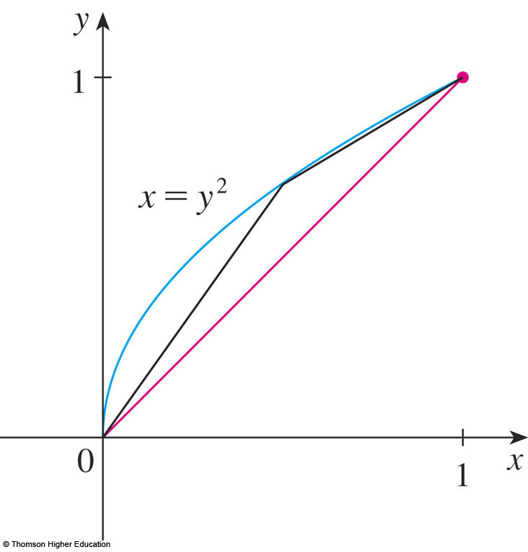
ARC LENGTH
The figure shows the arc of the parabola whose length is computed in Example 2, together with polygonal approximations
having n = 1 and n = 2
line segments,
respectively.

Slide 43
ARC LENGTH
For n = 1, the approximate length is
L₁ = , the diagonal of a square.

Slide 44
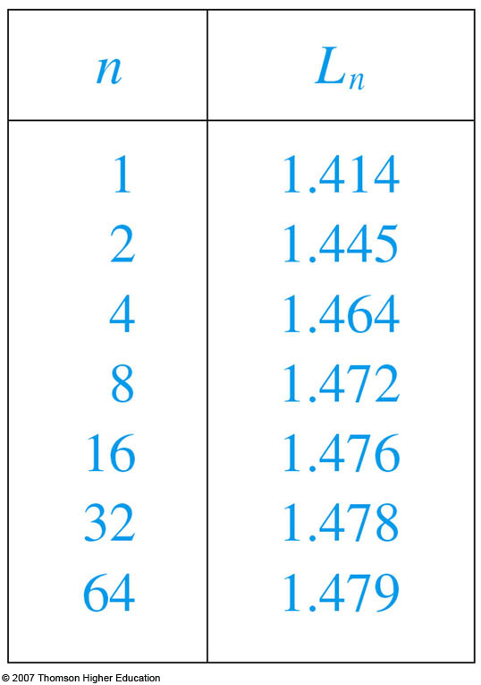
ARC LENGTH
The table shows the approximations L_{n}
that we get by dividing [0, 1] into n equal
subintervals.

Slide 45
ARC LENGTH
Notice that, each time we double the number of sides of the polygon, we get closer to
the exact length, which is:

Slide 46
ARC LENGTH
Due to the presence of the square root sign
in Formulas 2 and 4, the calculation of an arc length often leads to an integral that is very difficult or even impossible to evaluate explicitly.

Slide 47
ARC LENGTH
So, sometimes, we have to be content
with finding an approximation to the length of a curve—as in the following example.

Slide 48
ARC LENGTH
Example 3
a. Set up an integral for the length of the arc
of the hyperbola xy = 1 from the point (1, 1)
to the point (2, ½).
b. Use Simpson’s Rule (see Section 7.7)
with n = 10 to estimate the arc length.

Slide 49
ARC LENGTH
Example 3 a
We have:
So, the arc length is:

Slide 50
ARC LENGTH
Example 3 b
Using Simpson’s Rule with a = 1, b = 2,
n = 10, Δx = 0.1 and ,
we have:

Slide 51
ARC LENGTH FUNCTION
We will find it useful to have a function that measures the arc length of a curve from
a particular starting point to any other point
on the curve.

Slide 52
ARC LENGTH FUNCTION
So, suppose a smooth curve C has
the equation y = f(x), a ≤ x ≤ b.
Then, let s(x) be the distance along C
from the initial point P₀(a, f(a)) to the point
Q(x, f (x)).

Slide 53
THE ARC LENGTH FUNCTION
Equation 5
Then, s is a function, called the arc length function, and, by Formula 2,
  We have replaced the variable of integration by t
  so that x does not have two meanings.

Slide 54
ARC LENGTH FUNCTION
Equation 6
We can use Part 1 of the Fundamental Theorem of Calculus (FTC 1) to differentiate Equation 5 (as the integrand is continuous):

Slide 55
ARC LENGTH FUNCTION
Equation 6 shows that the rate of change of s with respect to x is always at least 1 and is equal to 1 when f’(x), the slope of the curve,
is 0.

Slide 56
ARC LENGTH FUNCTION
Equation 7
The differential of arc length is:

Slide 57
ARC LENGTH FUNCTION
Equation 8
Equation 7 is sometimes written in
the symmetric form
(ds)² = (dx)² + (dy)²

Slide 58
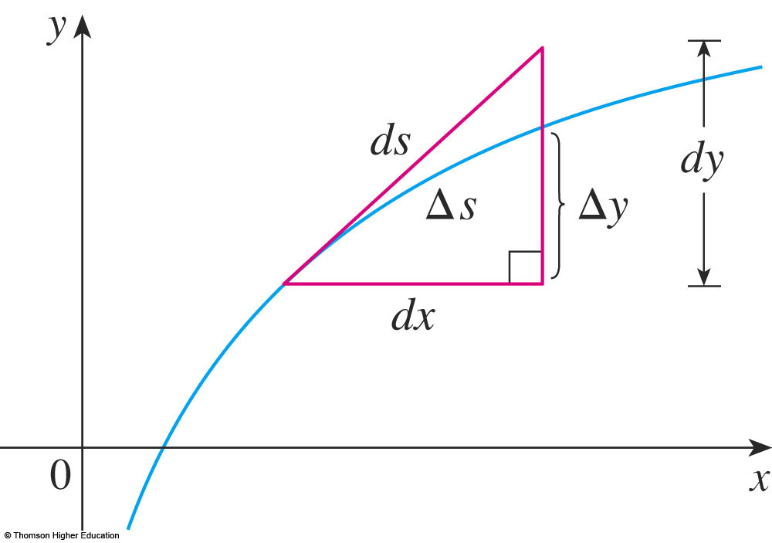
ARC LENGTH FUNCTION
The geometric interpretation of Equation 8 is shown here.
  It can be used as
  a mnemonic device
  for remembering
  both Formulas 3
  and 4.

Slide 59
ARC LENGTH FUNCTION
If we write L = ∫ ds, then, from Equation 8, we can either solve to get:
  Equation 7, which gives Formula 3.
  , which gives Formula 4.

Slide 60
ARC LENGTH FUNCTION
Example 4
Find the arc length function for
the curve y = x² – ⅛ ln x taking P₀(1, 1) as the starting point.

Slide 61
ARC LENGTH FUNCTION
Example 4
If f’(x)= x² – ⅛ ln x, then
  .
  .
  .

Slide 62
ARC LENGTH FUNCTION
Example 4
Thus, the arc length function
is given by:

Slide 63
ARC LENGTH FUNCTION
Example 4
For instance, the arc length along
the curve from (1, 1) to (3, f(3)) is:

Slide 64
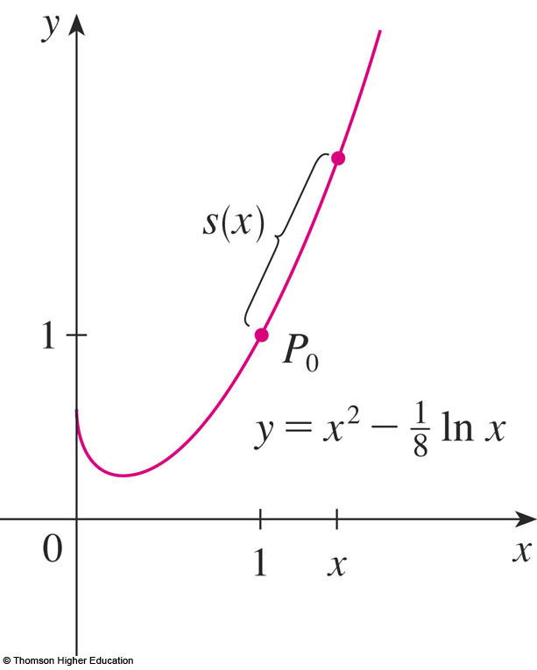
ARC LENGTH FUNCTION
The figure shows the interpretation of
the arc length function in Example 4.

Slide 65
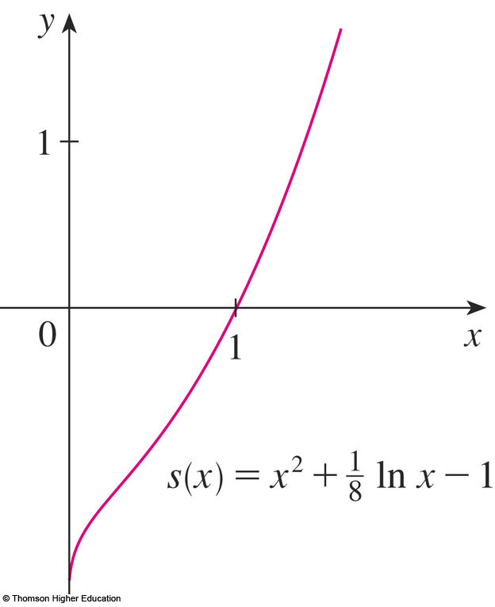
ARC LENGTH FUNCTION
This figure shows the graph of this arc length function.
  Why is s(x) negative
  when x is less than 1?

