Slide 1
The Fundamental Theorem of Calculus
Prof. D. G. Patel,
Mathematics Department,
Pramukh Swami Science College, Kadi

Slide 2
What is the Fundamental Theorem of Calculus?
Why is it fundamental?

Slide 3
The Fundamental Theorem of Calculus:
1.
If then
2.
(under suitable hypotheses)

Slide 4
The most common description of the FTC is that
“The two central operations of calculus, differentiation and integration, are inverses of each other.” —Wikipedia (en.wikipedia.org)

Slide 5
The most common description of the FTC is that
“The two central operations of calculus, differentiation and integration, are inverses of each other.” —Wikipedia (en.wikipedia.org)
Problem: For most students, the working definition of integration is the inverse of differentiation. What makes this a theorem, much less a fundamental theorem?

Slide 6
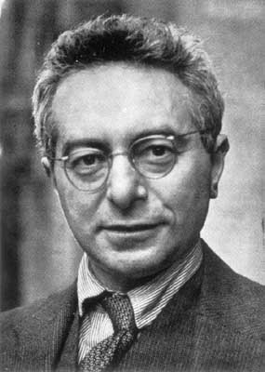
Richard Courant, Differential and Integral Calculus (1931), first calculus textbook to state and designate the Fundamental Theorem of Calculus in its present form.
First widely adopted calculus textbook to define the integral as the limit of Riemann sums.

Slide 7
Moral: The standard description of the FTC is that
“The two central operations of calculus, differentiation and integration, are inverses of each other.” —Wikipedia (en.wikipedia.org)
A more useful description is that the two definitions of the definite integral:
The difference of the values of an anti-derivative taken at the endpoints, [definition used by Granville (1941) and earlier authors]
The limit of a Riemann sum, [definition used by Courant (1931) and later authors]
yield the same value.

Slide 8
Look at the questions from the 2004 AB exam that involve integration.
For which questions should students use the anti-derivative definition of integration?
For which questions should students use the limit of Riemann sums definition of derivative?

Slide 9
2004 AB3(d)
A particle moves along the y-axis so that its velocity v at time t ≥ 0 is given by v(t) = 1 – tan^{–1}(e^{t}). At time t = 0, the particle is at y = –1. Find the position of the particle at time t = 2.
y '(t) = v(t) = 1 – tan^{–1}(e^{t})
y(t) = ?

Slide 10
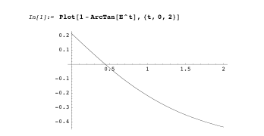

Slide 11
Velocity × Time = Distance
time
velocity
distance

Slide 12
Areas represent distance moved (positive when v > 0, negative when v < 0).

Slide 13
This is the total accumulated distance from time t = 0 to t = 2.

Slide 14
Change in y-value equals
Since we know that y(0) = –1:

Slide 15

The Fundamental Theorem of Calculus (part 1):
If then

Slide 16
The Fundamental Theorem of Calculus (part 1):
If then
If we know an anti-derivative, we can use it to find the value of the definite integral.

Slide 17
The Fundamental Theorem of Calculus (part 1):
If then
If we know an anti-derivative, we can use it to find the value of the definite integral.
If we know the value of the definite integral, we can use it to find the change in the value of the anti-derivative.

Slide 18
2004 AB1/BC1
Traffic flow … is modeled by the function F defined by
(a) To the nearest whole number, how many cars pass through the intersection over the 30-minute period?
(c) What is the average value of the traffic flow over the time interval 10 ≤ t ≤ 15?

Slide 19
Moral:
Definite integral evaluation on a graphing calculator (without CAS) is integration using the definition of integration as the limit of Riemann sums.
Students need to be comfortable using this means of integration, especially when finding an explicit anti-derivative is difficult or impossible.

Slide 20
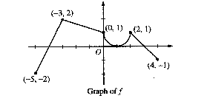
AB 5 (2004)
(c) Find the absolute minimum value of g on the closed interval [–5,4]. Justify your answer.

Slide 21
AB 5 (2004)
(c) Find the absolute minimum value of g on the closed interval [–5,4]. Justify your answer.
FTC (part 2) implies that
g decreases on [–5,– 4], increases on [– 4,3], decreases on [3,4], so candidates for location of minimum are x = – 4, 4.

Slide 22
AB 5 (2004)
Use the concept of the integral as the limit of the Riemann sums which is just signed area: the amount of area betweeen graph and x-axis from –3 to 3 is much larger than the amount of area between graph and x-axis from 3 to 4, so g(4) > g(– 4).

Slide 23
AB 5 (2004)
The area between graph and x-axis from – 4 to –3 is 1, so the value of g increases by 1 as x increases from – 4 to –3. Since g(–3) = 0, we see that g(– 4) = –1. This is the absolute minimum value of g on [–5,4].

Slide 24
Archimedes (~250 BC) showed how to find the volume of a parabaloid:
Volume = half volume of cylinder of radius b, length a
=

Slide 25
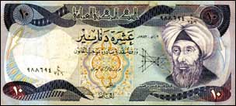
The new Iraqi 10-dinar note
Abu Ali al-Hasan ibn al-Hasan ibn al-Haytham (965–1039)
a.k.a. Alhazen, we’ll refer to him as al-Haytham

Slide 26
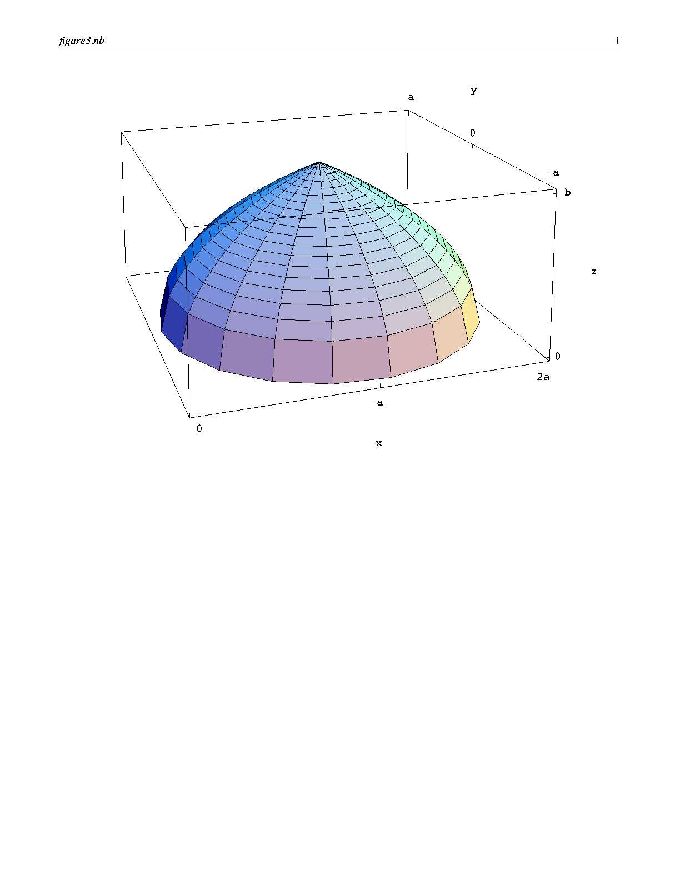
Al-Haytham considered revolving around the line x = a:
Volume =

Slide 27
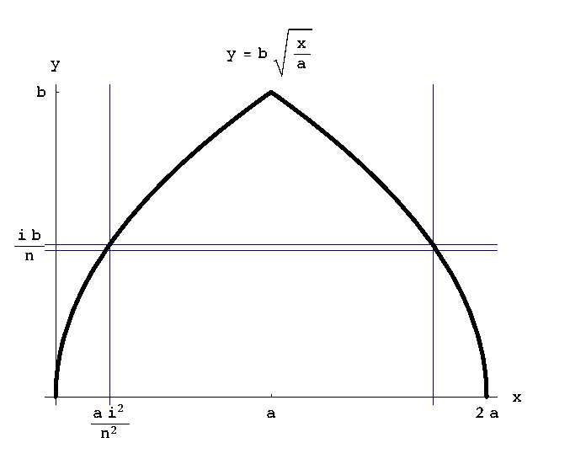

Slide 31
Using “Pascal’s” triangle to sum kth powers of consecutive integers
Al-Bahir fi'l Hisab (Shining Treatise on Calculation), al- Samaw'al, Iraq, 1144
Siyuan Yujian (Jade Mirror of the Four Unknowns), Zhu Shijie, China, 1303
Maasei Hoshev (The Art of the Calculator), Levi ben Gerson, France, 1321
Ganita Kaumudi (Treatise on Calculation), Narayana Pandita, India, 1356

Slide 32
HP(k,i ) is the House-Painting number
1
2
3
4
5
6
7
8
It is the number of ways of painting k houses using exactly i colors.

Slide 33
Using this formula, it is relatively easy to find the exact value of the area under the graph of any polynomial over any finite interval.

Slide 34
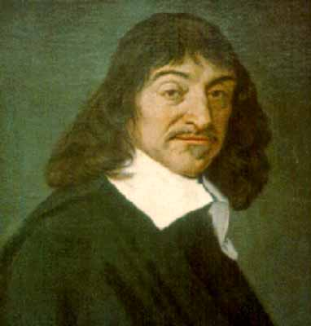
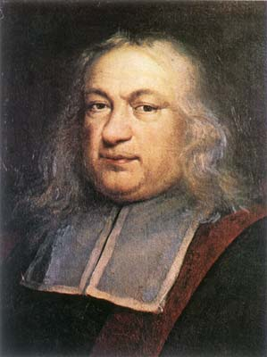
1630’s Descartes, Fermat, and others discover general rule for slope of tangent to a polynomial.
René Descartes
Pierre de Fermat

Slide 35
1630’s Descartes, Fermat, and others discover general rule for slope of tangent to a polynomial.
1639, Descartes describes reciprocity in letter to DeBeaune

Slide 36
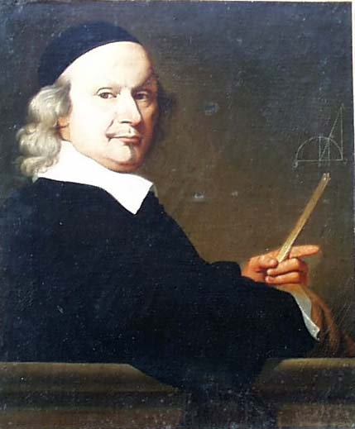
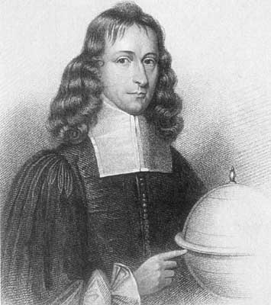
Hints of the reciprocity result in studies of integration by Wallis (1658), Neile (1659), and Gregory (1668)
John Wallis
James Gregory

Slide 37
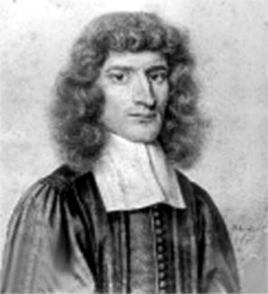
First published proof by Barrow (1670)
Isaac Barrow

Slide 38
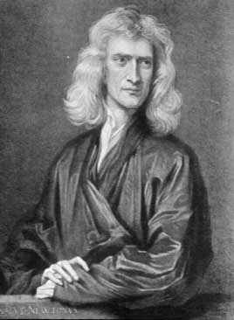
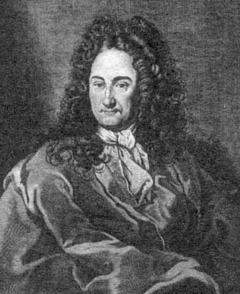
Discovered by Newton (1666, unpublished); and by Leibniz (1673)
Isaac Newton
Gottfried Leibniz

Slide 39
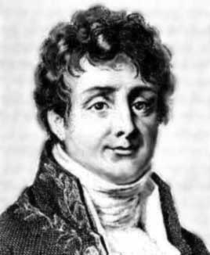
S. F. LaCroix (1802):“Integral calculus is the inverse of differential calculus. Its goal is to restore the functions from their differential coefficients.”
Joseph Fourier (1807): Put the emphasis on definite integrals (he invented the notation ) and defined them in terms of area between graph and x-axis.

Slide 40
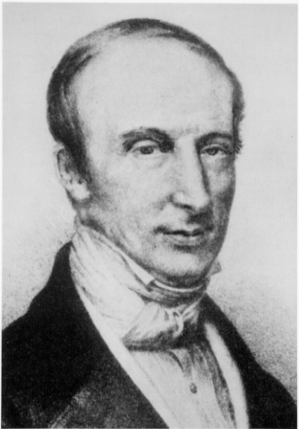
A.-L. Cauchy: First to define the integral as the limit of the summation
Also the first (1823) to explicitly state and prove the second part of the FTC:

Slide 41
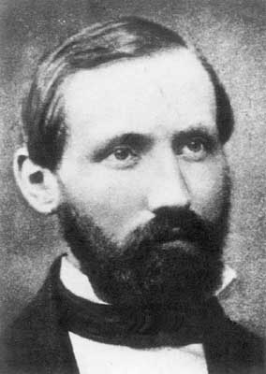
Bernhard Riemann (1852, 1867) On the representation of a function as a trigonometric series
Defined as limit of

Slide 42
Bernhard Riemann (1852, 1867) On the representation of a function as a trigonometric series
Defined as limit of
When is a function integrable?
Does the Fundamental Theorem of Calculus always hold?

Slide 43
The Fundamental Theorem of Calculus:
2.
Riemann found an example of a function f that is integrable over any interval but whose antiderivative is not differentiable at x if x is a rational number with an even denominator.

Slide 44
The Fundamental Theorem of Calculus:
1. If then

Slide 45
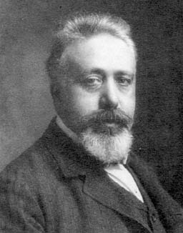
The Fundamental Theorem of Calculus:
1. If then
Vito Volterra, 1881, found a function f with an anti-derivative F so that F'(x) = f(x) for all x, but there is no interval over which the definite integral of f(x) exists.

Slide 46
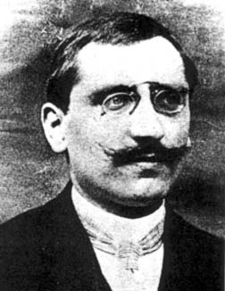
Henri Lebesgue, 1901, came up with a totally different way of defining integrals that is the same as the Riemann integral for nice functions, but for which part 1 of the FTC is always true.

