Slide 1
Boolean Algebra
Digital Logic

Slide 2
objective
Understand the relationship between Boolean logic and digital computer circuits.
Learn how to design simple logic circuits.
Understand how digital circuits work together to form complex computer systems.

Slide 3
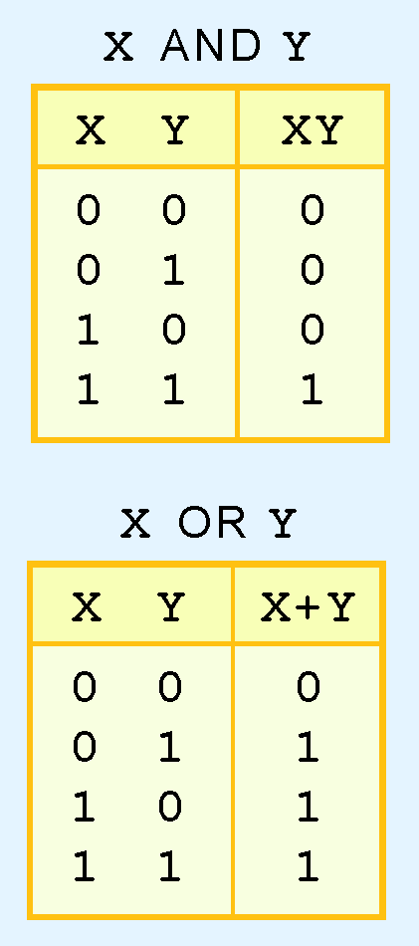
Logical operator
A Boolean operator can be completely described using a truth table.
The truth table for the Boolean operators AND is shown at below.
The AND operator is also known as a Boolean product. The OR operator is the Boolean sum.

Slide 4
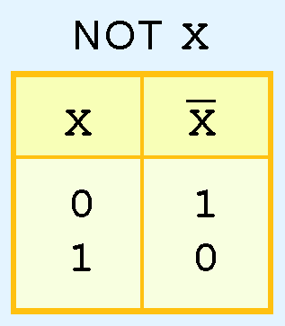
Logical operator
The truth table for the Boolean NOT operator is shown at the right.
The NOT operation is most often designated by an over bar. It is sometimes indicated by a prime mark ( ‘ ) or an “elbow” (¬).

Slide 5
Logical operator
A Boolean function has:
  At least one Boolean variable,
  At least one Boolean operator, and
  At least one input from the set {0,1}.
It produces an output that is also a member of the set {0,1}.

Slide 6
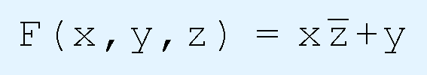
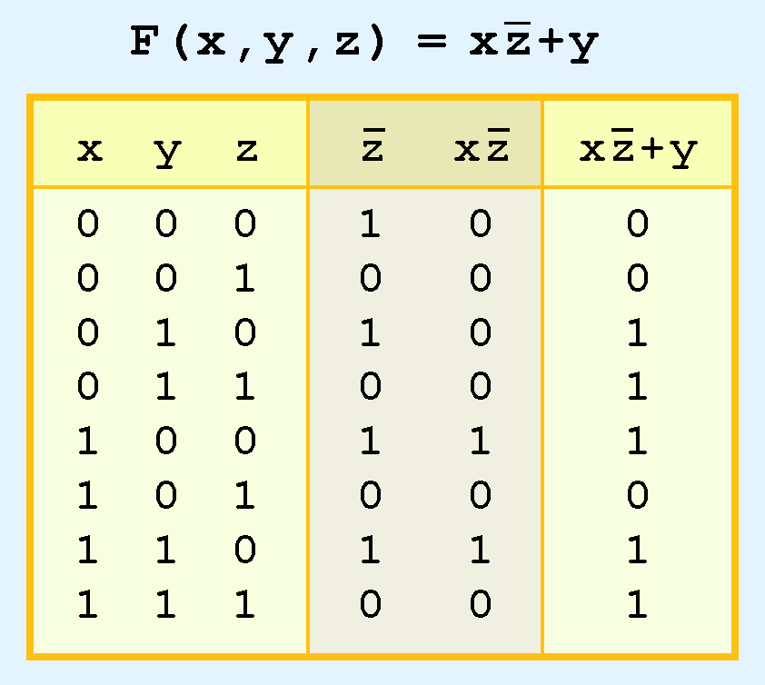
Logical operator
The truth table for the Boolean function:
is shown at the below.

Slide 7
Logical operator
As with common arithmetic, Boolean operations have rules of precedence.
The NOT operator has highest priority, followed by AND and then OR

Slide 8
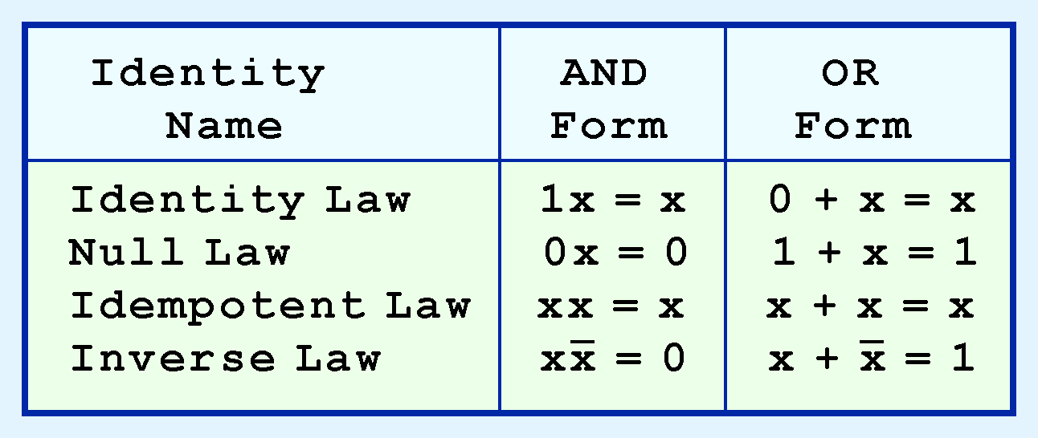
Boolean Algebra
Most Boolean identities have an AND (product) form as well as an OR (sum) form. We give our identities using both forms. Our first group is rather intuitive.

Slide 9
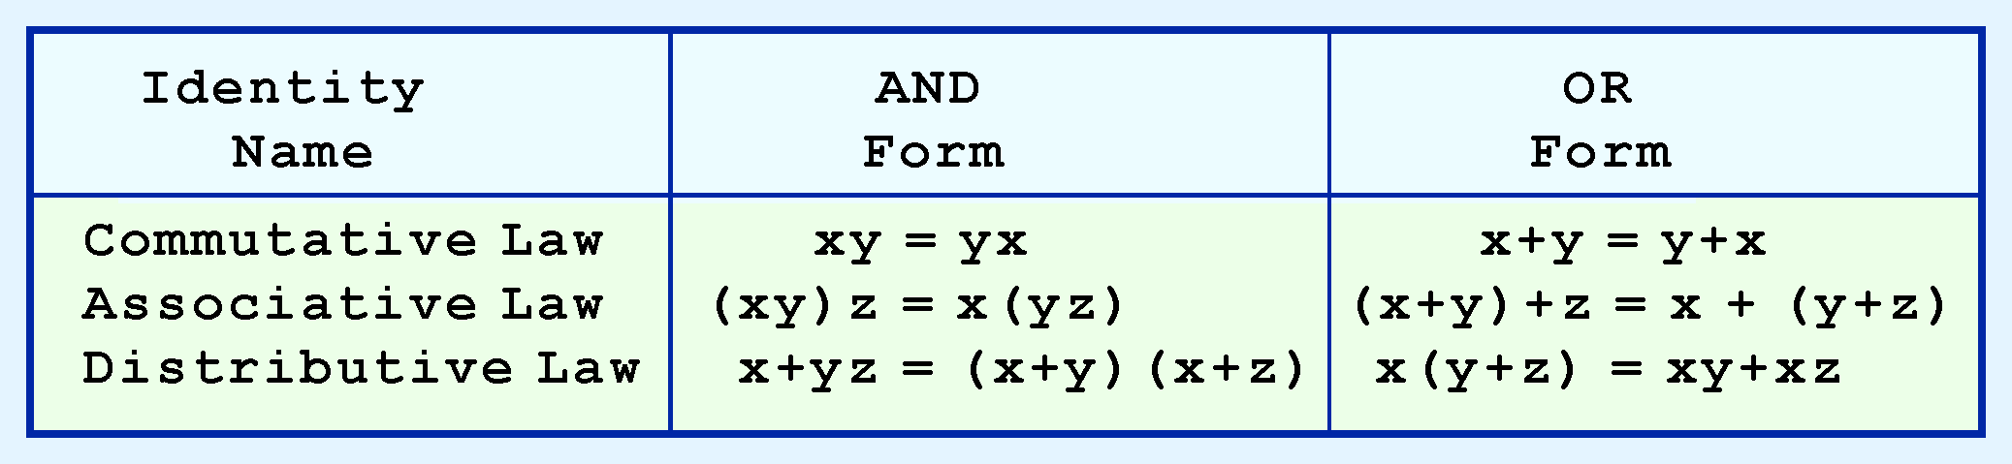
Boolean Algebra
Our second group of Boolean identities should be familiar to you from your study of algebra:

Slide 10
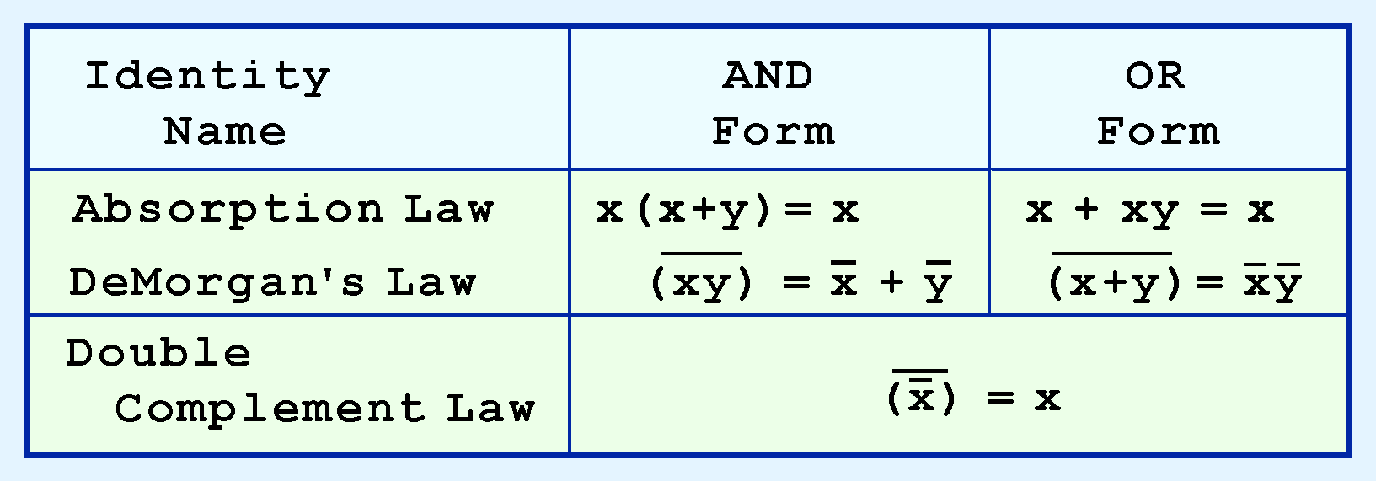
Boolean Algebra
Our last group of Boolean identities are perhaps the most useful.
If you have studied set theory or formal logic, these laws are also familiar to you.

Slide 11
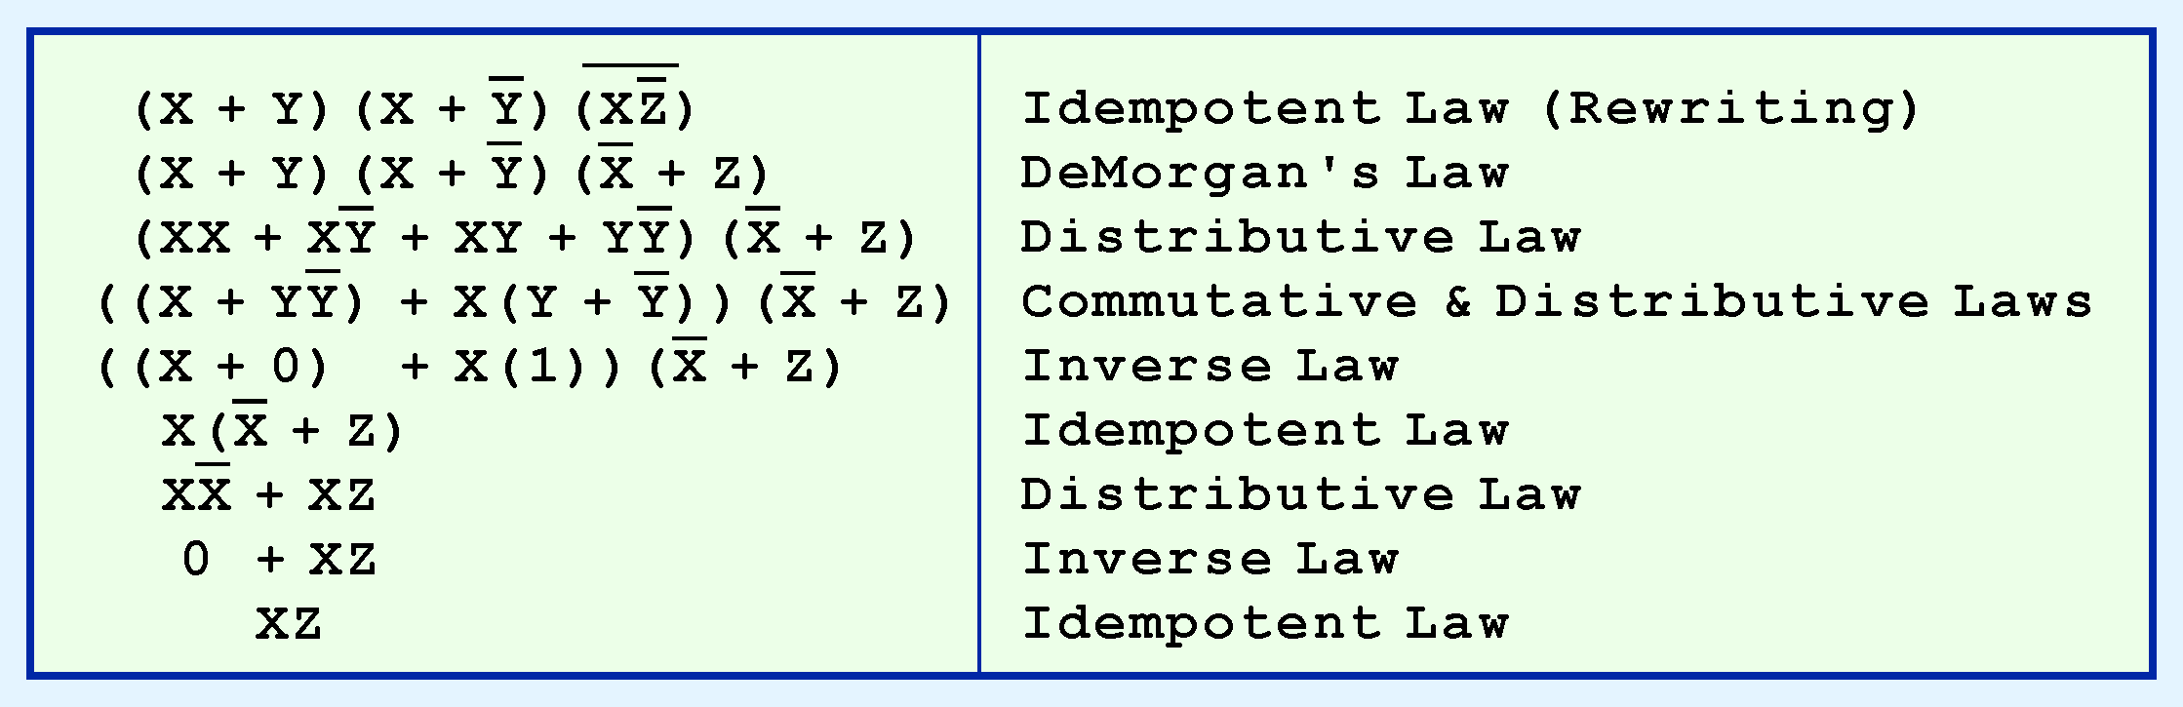
Boolean Algebra
We can use Boolean identities to simplify the function:
as follows:

Slide 12
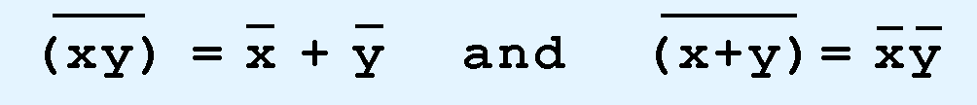
Boolean Algebra
DeMorgan’s law provides an easy way of finding the complement of a Boolean function.
Recall DeMorgan’s law states:

Slide 13
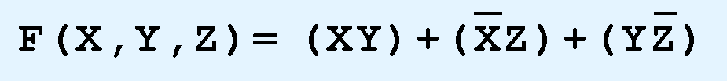
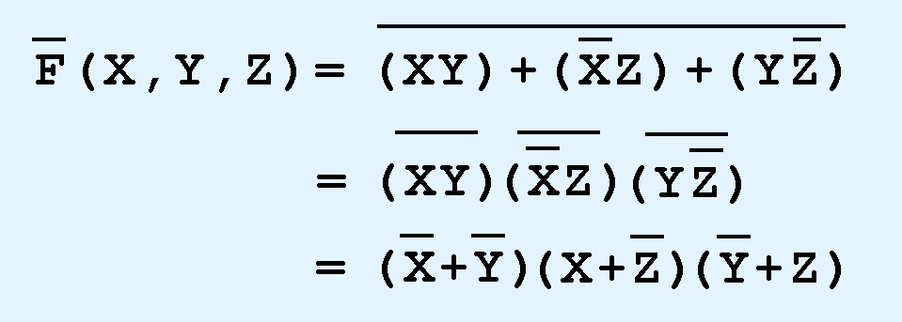
Boolean Algebra
DeMorgan’s law can be extended to any number of variables.
Replace each variable by its complement and change all ANDs to ORs and all ORs to ANDs.
Thus, we find the the complement of:
is:

Slide 14
Logic Gates
We have looked at Boolean functions in abstract terms.
In this section, we see that Boolean functions are implemented in digital computer circuits called gates.
A gate is an electronic device that produces a result based on two or more input values.

Slide 15
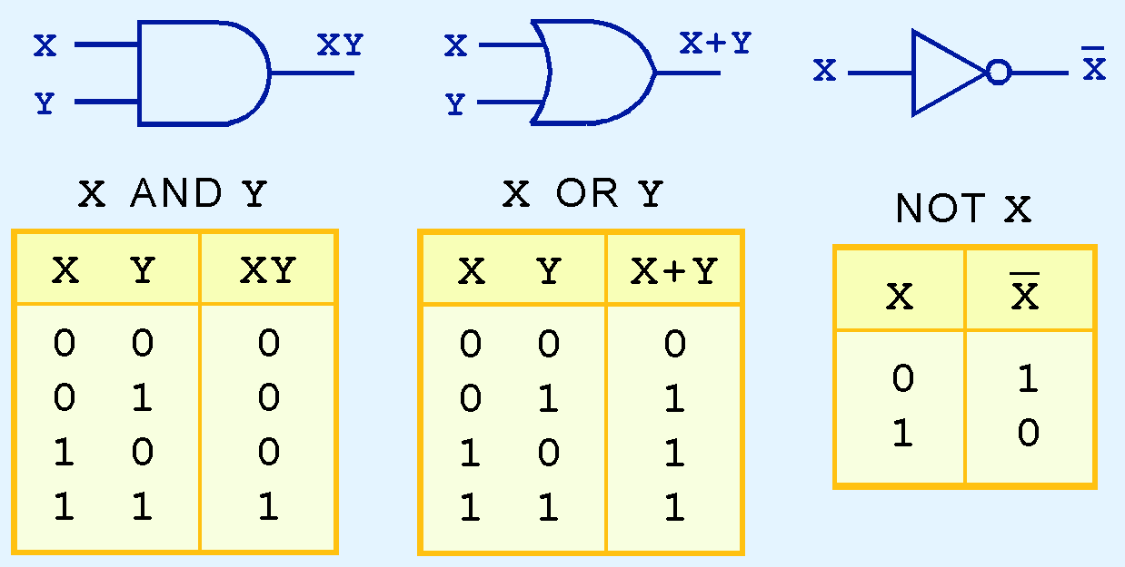
Logic Gates
The three simplest gates are the AND, OR, and NOT gates.
They correspond directly to their respective Boolean operations, as you can see by their truth tables

Slide 16
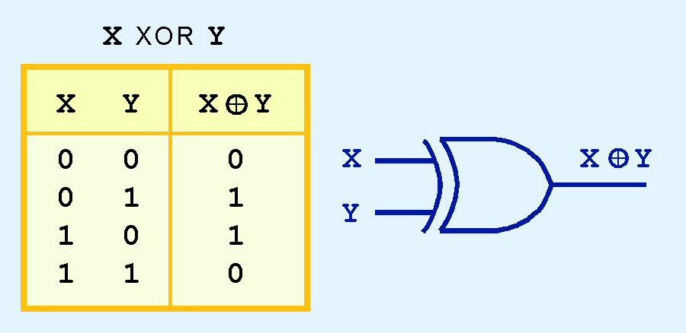
Logic Gates
Another very useful gate is the exclusive OR (XOR) gate.
The output of the XOR operation is true only when the values of the inputs differ.

Slide 17
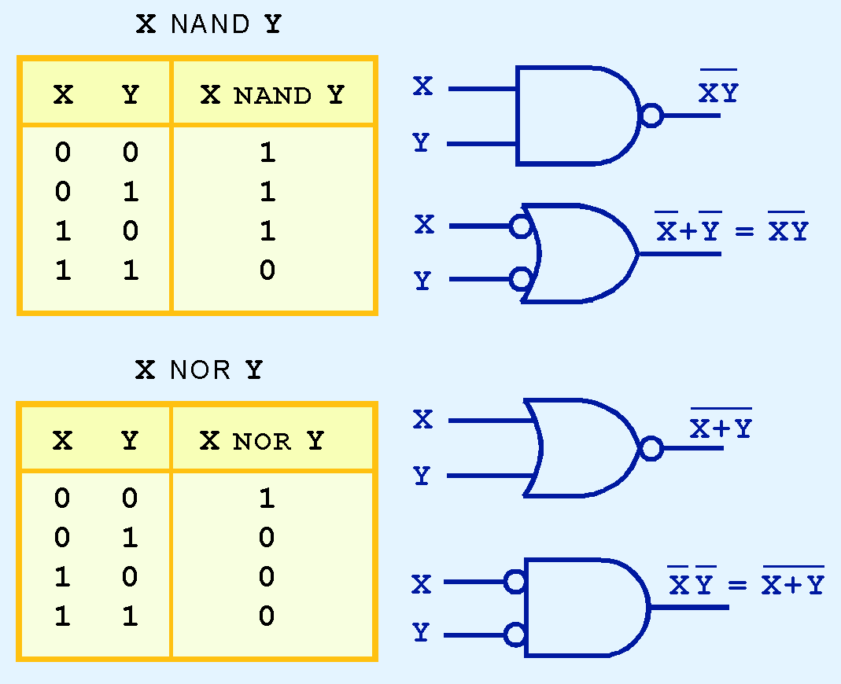
Logic Gates
NAND and NOR are two very important gates. Their symbols and truth tables are shown at the right.

Slide 18
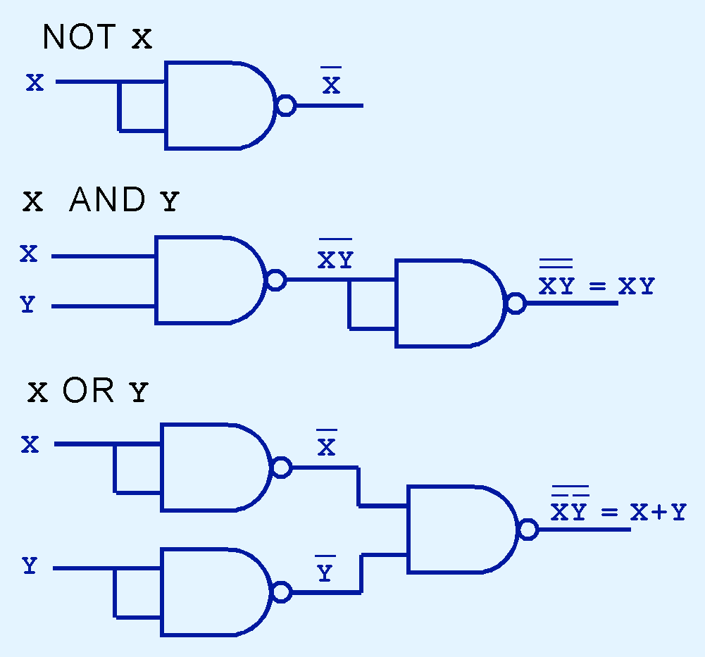
Logic Gates
NAND and NOR are known as universal gates because they are inexpensive to manufacture and any Boolean function can be constructed using only NAND or only NOR gates.

Slide 19
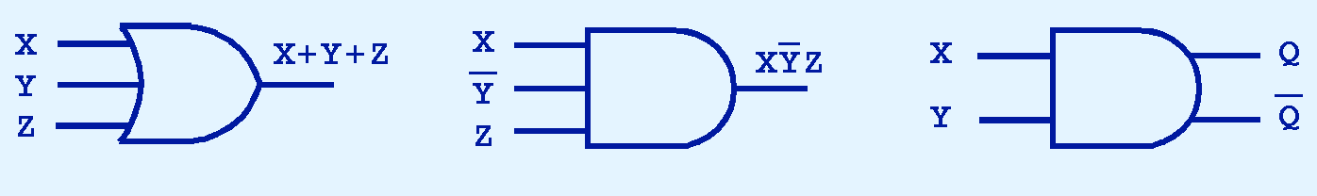
Logic Gates
Gates can have multiple inputs and more than one output.
  A second output can be provided for the complement of the operation.

