Slide 1

DeMoivre’s Theorem
The Complex Plane

Slide 2
Complex Number
A complex number z = x + yi can be interpreted geometrically as the point (x, y) in the complex plane. The x-axis is the real axis and the y-axis is the imaginary axis.

Slide 3
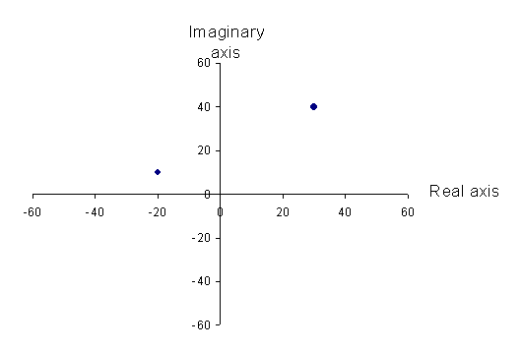
Complex Plane

Slide 4
Magnitude or Modulus of z
Let z = x + yi be a complex number. The magnitude or modulus of z, denoted by |z| is defined as the distance from the origin to the point (x, y). In other words

Slide 5
Polar Form of a Complex Number
If r ≥ 0 and 0 ≤ θ ≤ 2π, the complex number
z = x + yi may be written in polar form as
z = x + yi = (r cos θ) + (r sin θ)i or
z = r (cos θ + i sin θ)
The angle θ is called the argument of z.
|z| = r

Slide 6
Plotting a Point in the Complex Plane and Writing it in Polar Form
Plot the point corresponding to z = 4 – 4i and write an expression for z in polar form
Plot the point

Slide 7
Plot the Point in the Complex Plane and Convert from Polar to Rectangular Form

Slide 8
Write Numbers in Rectangular Form
2 (cos 120º + i sin 120º)

Slide 9
Multiplying and Dividing Complex Numbers

Slide 10
Finding Products and Quotients of Complex Numbers in Polar Form
If z = 3 (cos 20º + i sin 20º) and
w = 5 (cos 100º + i sin 100º), find
(a) zw
(b) z/w
(c) w/z

Slide 11
DeMoivre’s Theorem
DeMoivre’s Theorem is a formula for raising a complex number to the power n.
If z = r (cos θ + i sin θ) is a complex number, then
z^{n} = r^{n} [(cos (nθ) + i sin (nθ)]
where n ≥ 1 is a positive integer.

Slide 12
Using DeMoivre’s Theorem
Write [2(cos 20º + i sin 20º)]³ in the standard form a + bi.

Slide 13
Using DeMoivre’s Theorem
= 2³ [(cos (3 x 20º) + i sin (3 x 20º)]
= 8 (cos 60º + i sin 60^{o)}

Slide 14
Using DeMoivre’s Theorem
Write (1 + i)⁵ in standard form a + bi
First we have to change to (1 + i) to polar form

Slide 15
Using DeMoivre’s Theorem

Slide 16
Finding Complex Roots
Let w = r(cos θ₀ + i sin θ₀) be a complex number and let n ≥ 2 be an integer. If w ≠ 0, there are n distinct complex roots of w, given by the formula

Slide 17
Finding Complex Roots
Find the complex fourth roots of -16i
First we have to change the number to polar form

Slide 18
Finding Complex Roots

Slide 19
Finding Complex Roots

Slide 20
Finding Complex Roots

