Slide 1
Pramukh Swami Science and H.D.Patel Arts College
Topiic: Greek Tragedy
By:Mr.Samir Pandya

Slide 2
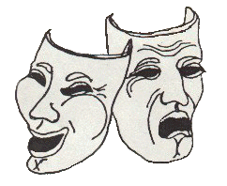
Greek Tragedy

Slide 3
Aristotle’s definition
Aristotle defines tragedy as “the imitation of an action which is serious, complete, of a certain magnitude, couched in poetic language. It should be dramatic, with incidents arousing pity and fear, which bring about a purgation of these emotions.”
Pity is aroused in the audience for the character(s), and we fear lest the same misfortune happen to us. Purgation/catharsis is a cleansing; a release of emotions.
According to Aristotle, “comedy portrays men as worse than they are and tragedy as better than in actual life.”
He also notes that Sophocles “drew men as they ought to be.”

Slide 4
Tragic Hero
Characteristics of a tragic hero:
  Undergoes a morally significant struggle that ends disastrously.
  Essentially a superior person who is treated sympathetically (we like him in spite of what the hero might do)
  His destiny or choice is to go down fighting rather than submit and thus pluck a moral victory from a physical defeat.
  Not all good or all bad (very human)
  Has a high, respected position to ignominy or unhappiness or death.

Slide 5
Tragic flaw (Hamartia)
Hamartia – some defect in the tragic character that helps cause his own ruin. For the Greeks this flaw is hubris (excessive pride). The flaw may seem to be jealousy, anger, ambition, etc., but it will always be because the character thinks himself too superior in some way. Because of this hubris, whatever happens to the tragic hero is not all undeserved.

Slide 6
Classic Moments in the tragic plot:
Reversal of situation (peripety) – good begins to slide or go bad
Recognition (a.k.a. epiphany) – discovery of the critical fact – the hero realizes his own flaw has brought him to this low point.
Scene of suffering – destructive or painful action such as a death on the stage, bodily agony, wounds, etc. (the suffering and final submission of the hero)

Slide 7
Greek Playwrights
3 Tragedians:
  Euripides (480-406 B.C.) – expresses weariness and disillusion of war-torn years at the end of the 5th century. Concern for realism and a determination to expose social, political, and religious injustices. He believes in the existence of irrational forces (gods), but he does not deem them worthy of respect (therefore, he was charged for impiety). “Shows man as he is.” Wrote 90 plays including Medea, Hippolytus, The Trojan Women, and Electra.
  Aeschylus (525-456 B.C.) – earliest writer of Greek tragedy. Wrote about 80 plays – most famous is Oresteia. Plays are deeply patriotic and religious. Aesychylus added a second actor to plays. Concerned with problems of guilt and punishment over several generations.
  Sophocles (496-406 B.C.) – not concerned with problems of guilt and punishment over several generations; he dealt with a specific struggle of a strong individual against fate. Wrote single plays (rather than trilogies); Sophocles added a third actor, a fixed chorus size at 15, and used scene-printing. Wrote 100 plays including Ajax, Antigone, Oedipus Rex, Philoctetes.
One Comedy Writer:
  Aristophanes: greatest Greek writer of comedy. Wrote Clouds, Birds, Frogs, and Lysistrata.

Slide 8
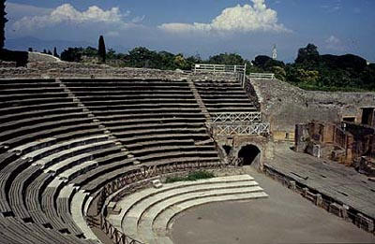
The Greek Theater
2 Main types of drama: tragedy and comedy.
Theatrical events were performed annually at the festival of Dionysus, which lasted 5 or 6 days: the Dionysis. Going to the theater was to take part in a religious ritual.
Competition among writers: Each author submitted 4 plays (tetralogy) to be performed in one day (3 tragedies – trilogy – and a satyr play.
Plots were religious and drawn from mythology (dealt with the relationship between humans and the divine). Actors wore masks, costumes, and raised shoes. Audiences were familiar with the stories.
Knowing the story allowed for dramatic irony (situations or speeches that have one meaning to the play’s characters but another for the audience, who knows more than the character about a given situation).

Slide 9
Dramatic Unities
Time – 24 hours for the action of the play.
Place – no change of scenery
Action – no subplot (an action which happens elsewhere is told by another character)

Slide 10
Structure of Tragedy
Prologue – introductory section that gives the background (usually expository rather than dramatic)
Parados – entrance of chorus; chorus chants more background to the story.
Episodes and Stasimon – Action begins with the first episode (usually 5 episodes) followed by a parados (chorus). The choral odes are called stasima.
Exodus – the final action of the play. 2 features: messenger speech and the deus ex machina, in which the deity is brought in to intervene in the action.
Chorus – there is always a chorus in Greek tragedy. Chorus fulfills several functions:
  Members sang, danced and played instruments
  Ideal audience – responding to the action as the poet intended.
  Modulated the atmosphere and tone (representative of typical Athenian citizens – conservative but not submissive)
  Questions new characters as to origin or purpose
  Choral odes showed the passage of time.

Slide 11
Theater and Equipment
Open air theater. The theater of Dionysus in Athens had more than 17,000 seats.
Theatron – the seats for the audience were arranged like a horseshoe in rising tiers.
Orchestra – circular area at ground level.
Thymele – an altar in the center of the orchestra to Dionysus on which sacrifices were made.
Skene – the scene building on the side of the orchestra that had a backdrop with doors for entrances and exits.
Proscenium – the level area in front of the skene for action of the play.
Technical equipment:
  Eccyclema – wheeled platform rolled out of the skene to reveal action that had taken place indoors (very violent scenes)
  The “machine” – mechanical contrivance to lower gods to the proscenium from the tope of the skene.
  Devices to imitate lightening and thunder.
  Painted scenery.

Slide 12
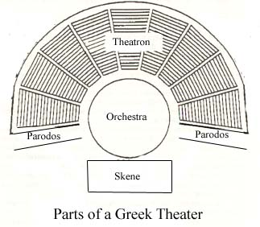
Greek Theater
http://academic.reed.edu/humanities/110tech/Theater.html#Theaters

Slide 13
Additional Reading
From Elements of Literature, 4th course:
  “Greek Drama: Out of Ritual” pp. 685-687
  “The Myth of Oedipus” pp. 688-689
  “Meet the Writer: Sophocles” p. 738
  “What is a tragic hero?” p. 739
From Edith Hamilton’s Mythology:
  “The Royal House of Thebes” pp. 266-280

