Slide 1
Pramukh Swami Science and H.D.patel Arts College
Topic: About an Epic
By: Dr.Alpa Jani

Slide 2
UNDERSTANDING EPIC

Slide 3
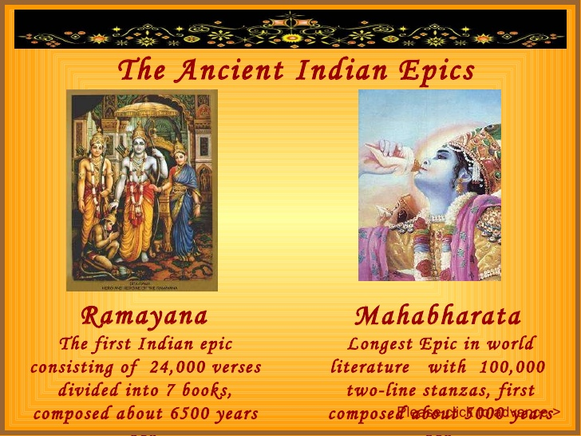

Slide 4
DEFINITION
A long poem, typically one derived from ancient oral tradition, narrating the deeds and adventures of heroic or legendary figures or the past history of a nation.
The word epic is derived from the Ancient Greek adjective, “epikos”, which means a poetic story.

Slide 5
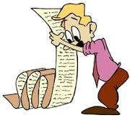
CHARACTERISTICS
The first and foremost characteristic of an epic is its bulky size . An epic is an extensive and prolonged narrative in verse. Usually, every single epic has been broken down in to multiple books. For example, Homer’s epics are divided into twelve books .Similarly, John Milton’s Paradise Lost has been divided into twelve books.

Slide 6
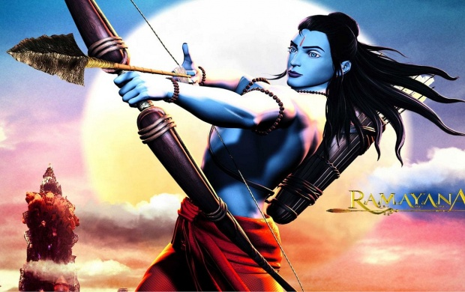
Another essential feature of an epic is the fact that it dwells upon the achievements of a historical or traditional hero, or a person of national or international significance. Every epic extolls the valour, deeds, bravery, character and personality of a person, who is having incredible physical and mental traits.

Slide 7
Exaggeration is also an important part of an epic. The poet uses hyperbole to reveal the prowess of a hero. He doesn’t think twice to use exaggeration to make an impression on the audience.

Slide 8
Morality is a key characteristic of an epic. The poet’s foremost purpose in writing an epic is to give a moral lesson to his readers. For instance, Johan Milton’s Paradise Lost is a perfect example in this regard. The poet wants to justify the ways of God to man through the story of Adam. This is the most didactic theme of the epic.

Slide 9
The theme of each epic is sublime, elegant and having universal significance. It may not be an insignificant theme, which is only limited to the personality or the locality of the poet. It deals with the entire humanity .Thus; John Milton’s Paradise Lost is a great example in this regard. The theme of this epic is certainly of great importance and deals with entire humanity. It’s them is to justify the ways of God to man.

Slide 10
Invocation to the Muse is another important quality of an epic. The poet, at the very beginning of the epic, seeks the help of the Muse while writing his epic. Look at the beginning lines of the Iliad, Odyssey and Paradise Lost.
The diction of every epic is lofty, grand and elegant. No trivial, common or colloquial language is used in epic. The poet tries to use sublime words to describe the events.

Slide 11
Use of Epic Simile is another feature of an epic. Epic simile is a far-fetched comparison between two objects, which runs through many lines to describe the valour, bravery and gigantic stature of the hero. It is also called Homeric simile

Slide 12
FEEL FREE TO ASK ABOUT ANY QUERRY
THANK YOU

