Slide 1
Welcome

Slide 2
PRESENTATION
ON
NOBEL PRIZE IN PHYSIOLOGY OR
MEDICINE (2017)

Slide 3
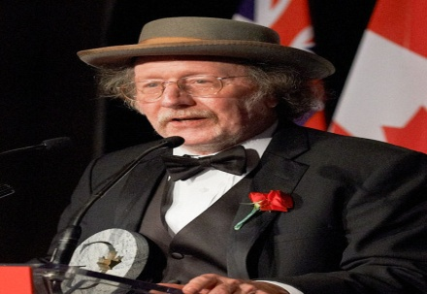
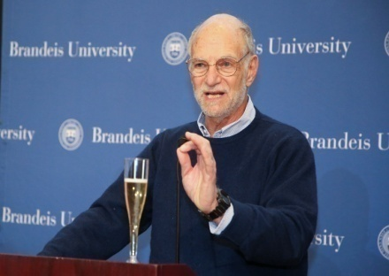
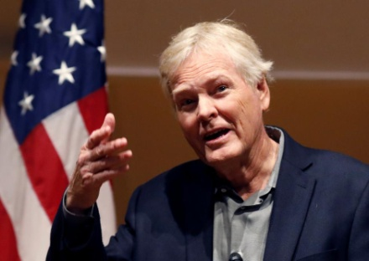
WINNERS
The NOBLE PRIZE in physiology or medicine 2017 was awarded on 2 october 2017(Monday) jointly to
Jeffrey C. Hall
Micheal Roshbash
Micheal W. Young

Slide 4
REASON
For their discoveries of molecular mechanisms controlling the circadian rhythm.

Slide 5
WORK
Humans have an internal biological clock that helps them anticipate and adapt to the regular rhythm of the day.
Jeffrey C. , Micheal M. , Micheal W. jointly worked on the actual reason how this rhythm works.
They were able to peek inside our biological clock and elucidates its inner working.

Slide 6
HOW
Using fruit flies as a model organism, they isolated a gene that controls the normal daily biological rhythm.
They showed that this gene encodes a protein that encodes a protein that accumulates in the cell during the night, and is then degraded during the day.

Slide 7
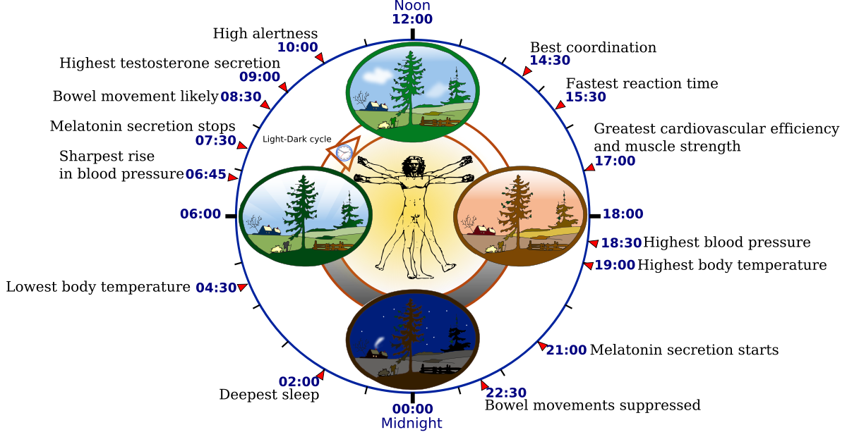
CIRCADIAN RHYTHM

Slide 8
IMPORTANCE OF CIRCADIAN BIOLOGY
Heralded the construction of “CHRONOTHERAPY” in the medicine industry.
If a drug is most toxic at a certain time of day, but most effective at another time of day, then timing the dose means you can use a smaller amount of drug.(This has made a big impact in CANCER TREATMENT and SLEEP THERAPY)
Another personalised area we’ll see changes in will be predictive medicine.
Predicting sepsis in hospitals and identifying people at risk for Alzheimer’s Disease.

Slide 9
THINGS CONTROLLED
Here’s a quick list of the ways it affects us:
JETLAG: When the time of day suddenly artificially changes. As a result, they can’t do their jobs as well, and you feel funky.
FERTILITY: Your sex drive has a circadian rhythm, and so do your sex hormones. Eg: ovulation happens in the early morning.
MENTAL FOCUS: You learn best at the time of day-but that optimum few hours is different for everyone.
NUTRITION: They control when you are hungry.
HEART ATTACK: Most heart attack occurs in the early morning.
AGING: The more these rhythmic pieces fall apart the more your risk of age-related maladies increase.

Slide 10
Jeffrey C. Hall
An American geneticist and chronobiologist .
Known for cloning the period gene.
University of Cambridge, Maine.
Fields : genetics
Hall spent his career examining the neurological component of fly courtship and behavioral rhythms.
Awarded : Gruber Prize in Neuroscience(2009), Gairdner foundation international award (2012)

Slide 11
Michael Warren Young
Currently at Rockefeller university.
An American Biologist and geneticist.
Known for circadian rhythms.
Dedicated over three decades to research studying genetically controlled patterns of sleep and wakefulness within Drosophila melanogaster.
Fields : Chronobiology , biology
Awarded : Gairdner foundation international award (2012)

Slide 12
Michael Morris Rosbash
An American geneticist and chronobiologist.
Fields : Genetics, chronobiology
Rosbash is a professor at Brandeis University and investigator at the Howard Hughes Medical Institute .
Awarded: Gruber prize in neuroscience (2009)

Slide 13
Thank You

