Slide 1

DNA, RNA
The Beginning….
Dr. Kamlesh shah

Slide 2


All living things are made of-
Water (an inorganic compound)
Other inorganic compounds (mostly salts)
Organic Compounds: {contain carbon and hydrogen}
Carbohydrates
Lipids(fats)
Proteins*
Nucleic Acids*
        *These are what we’ll talk about today

Slide 3

When we look at a living thing,
What we see is mostly PROTEIN-
So, how does an organism produce its particular protein?
As in, people protein vs tree protein?

Slide 4
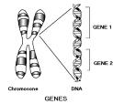
The answer is DNA!
The species-particular DNA sequences produce the species-particular proteins
GENES code for proteins
GENES are long strands of DNA on chromosomes

Slide 5

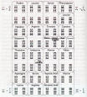
What is DNA?
DNA is the genetic code,
Instructions for heredity,
Components of genes,
Director of protein synthesis

Slide 6
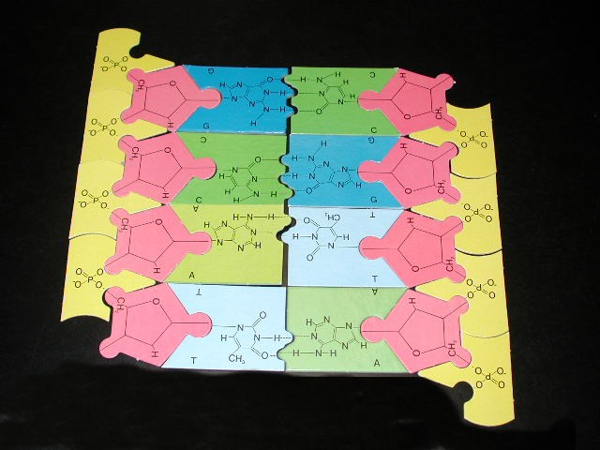
DNA is also
A type of nucleic acid
A type of organic compound
A polymer {a compound made of repeating subunits}

Slide 7
WHAT DOES “DNA” STAND FOR?

Slide 8
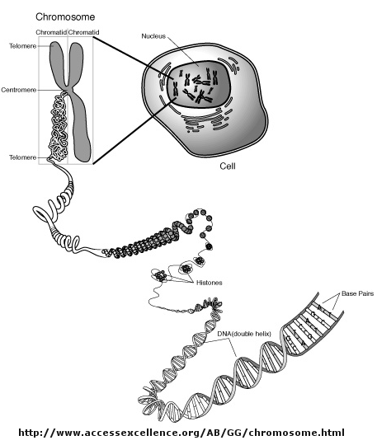
DNA’s proper name is-
Deoxyribonucleic acid!
Consists of a ribose SUGAR with a “missing oxygen” (that’s the de-oxy part)
And it’s found in the nucleus of eukaryotic organisms

Slide 9
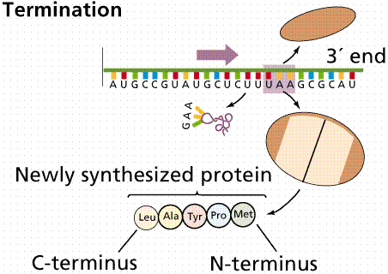
How does DNA code for protein synthesis?
First-what is “protein synthesis”?
It’s building, or assembling, a protein molecule from amino acids
Amino acids are smaller molecules found in the food we eat or produced in our cells
It happens at the ribosomes

Slide 10
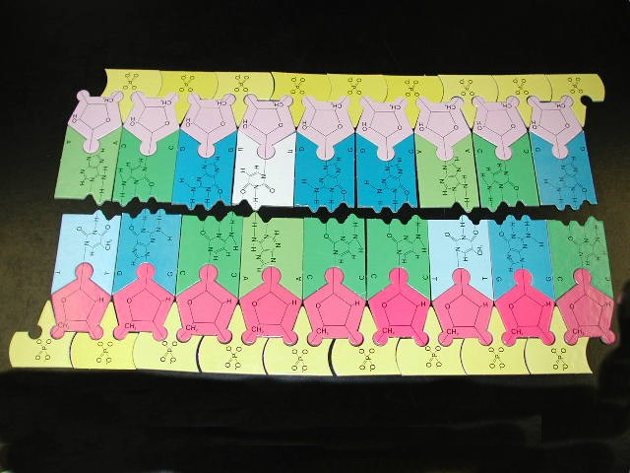
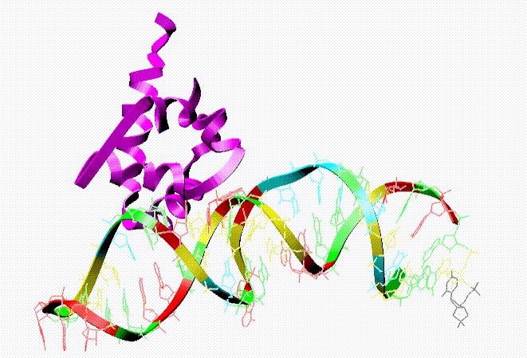
DNA and protein synthesis, then, happens this way:
1. DNA sequence codes (how letters are put together) produce messenger RNA sequence codes

Slide 11
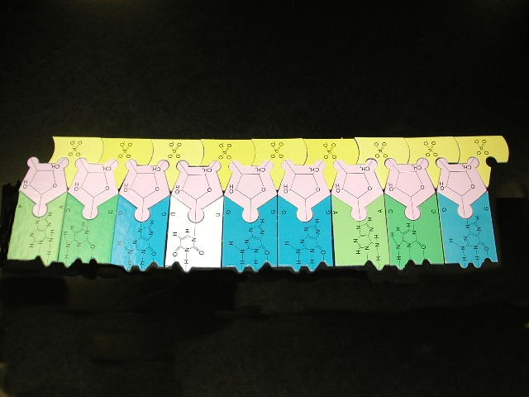
2. The messenger RNA leaves the nucleus and attaches to a ribosome in the cytoplasm

Slide 12
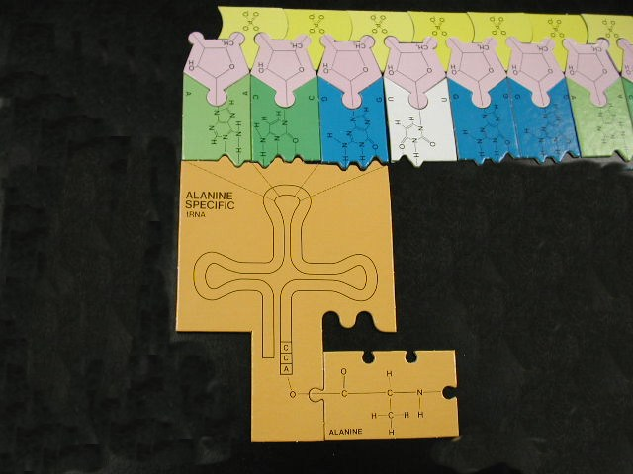
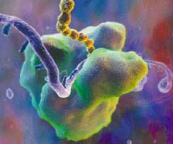
3. Transfer RNA brings amino acids to the ribosome to match the sequence codes

Slide 13
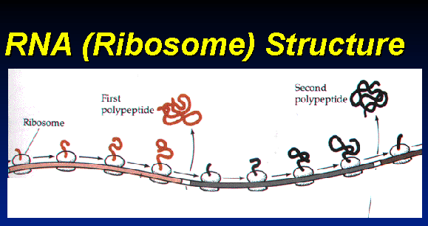
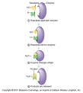
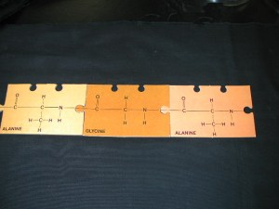

At the ribosome,
Amino acids bond together and form polypeptides,
Which bond together to make proteins
Some examples of proteins are:
  Melanin, the pigment that gives our skin color
  Enzymes, the catalysts that help digest our food

Slide 14

Well, that clears it up!

Slide 15
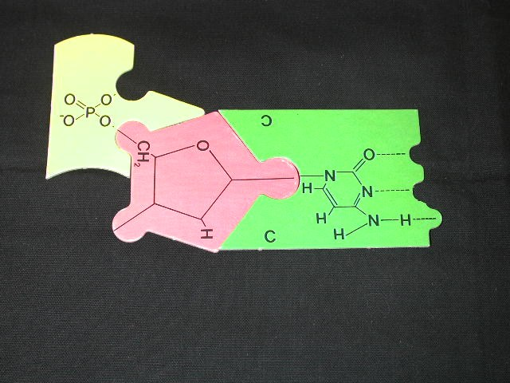
Structure of DNA
A nucleotide of DNA is the base unit
A nucleotide consists of a phosphate, a sugar, and a nitrogen base

Slide 16
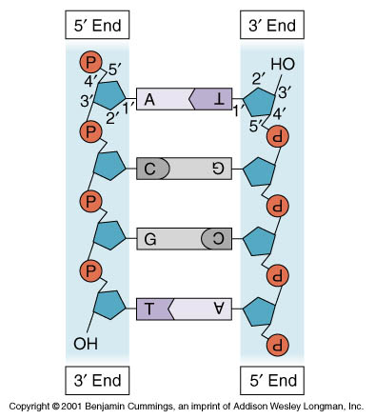
DNA is in a double strand
The nitrogen bases have compliment partners
Adenine-Thymine
Cytosine-Guanine

Slide 17
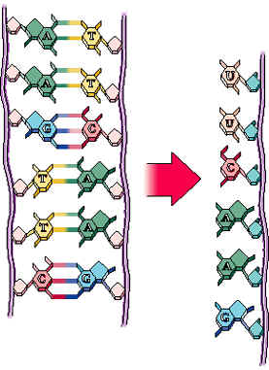
Just a note about RNA-
RNA is single-stranded and acts as a code for protein synthesis.
RNA is still made of nucleotides that have a phosphate, a sugar, and a nitrogen base
The sugar is different and the base-pairing is also different

