Slide 1
Antibiotic production

Slide 2
Introduction
Antibiotic: A substance produced by a microorganism that, in small amounts, inhibits another microbe.
Antibiotics are secondary metabolites produced by filamentous fungi & bacteria, particularly the actinomycetes.
Important antibiotics are β-lactums, penicillins & cephalosporins; along with aminoglycosides, such as streptomycin & tetracyclines.

Slide 3
Classification of antibiotics:
• Antibiotics that inhibit Cell wall synthesis
– Beta-lactams (penicillins, cephalosporins, Carbapenems, Monobactams
– Poly-peptides (bacitracin, vancomycin)
• Antibiotics that inhibit Protein synthesis
– Aminoglycosides
– Tetracyclins
– Macrolides
– Chloramphenicol
– Clindamycin
• Antagonists
– Sulfonamides
– Trimethoprim
• Quinolones

Slide 4
β-lactum antibiotic : Penicillin
A class of antibiotics that comes from mold(Fungi).
Discovered by accident in 1928 by Alexander Fleming.
Penicillin is the first anitbiotic to be produced on a large scale during 2nd world war.
Penicillin antibiotics include Penicillin G and V, ampicillin, phenoxymethylpenicillin, amoxicillin, etc. 1st-4th generations.
Over 100 types of biosynthetic penicillin available.
50 drugs that are now classified as penicillin.

Slide 6
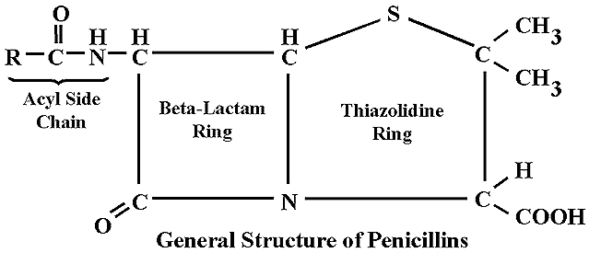

Slide 7
History
During world war II-importance realized, as penicillin had been used to treat many wounded soldiers.

Slide 8
How Penicillin Works
Resembles a protein (transpeptidase) needed for production of cell wall.
Penicillin binds to cell wall of bacteria, inhibit the binding of transpeptidase enzyme which required for the cross linking of peptide chains & lyses the bacterial cell wall.

Slide 9
Applications
38% used in human medicine
12% used in veterinary medicine
43% used as starting materials for the production of semisynthetic penicillins.
Used in labs as a selective bacteriostatic agent.
Used in preparation of various media.

Slide 10
Fermentative Production of Penicillin
Penicillin was the first important commercial product produced by an aerobic, submerged fermentation.
First antibiotic to have been manufacture in bulk.
It is fermented in a batch culture.
When penicillin was first made at the end of the second world war using the fungus Penicillium notatum, the yield was 1 mg dm⁻³.
Today, using a different species (P. chrysogenum) and a better extraction procedures the yield is 50 g dm⁻³.

Slide 11
Fermentative Production of Penicillin
The industrial production of penicillin was broadly classified in to two processes namely,
Upstream processing
  Selection of microorganisms
  Media formulation
  INOCULUM PREPARATION
  Fermentation process
  Fermentation condition
Downstream processing
Post harvest product recovery of penicillin - clarification, concentration, purification,
polishing and formulation till packaging.

Slide 12
Selection of microbes
Penicillium notatum
Penicillium chrysogenum NRRL 1951

Slide 13
Medium component
Carbon sources:
  Lactose acts as a very satisfactory carbon compound, provided that is used in a concentration of 6%.
  Molasses as a crude source of sucrose may be used.
  Animal & vegetable oils also used.
Nitrogen sources:
  Organic nitrogen source: Corn steep liquor (CSL) used
  Inorganic nitrogen source: Ammonium sulphate and ammonium acetate can be fed in to the medium.
  Ammonium sulphate also provide sulfur.

Slide 14
Precursors of penicillin side chain
  Phenyl acetic acid: Precursor for Penicillin G
  Phenoxy acetic acid: Precursor for Penicillin V
  Both required in relatively high conc.
  Both are fed in the fermentation medium continuously.

Slide 15
Mineral sources:
Phosphorus:
  Important source of phosphorus is phytic acid present in corn steep liquor.
  Phosphorus also added in the form of inorganic salts.
  A level of 250-500μg/ml of inorganic phosphate should be maintained.
Elements namely potassium, magnesium, sulphur, zinc and copper are essential for penicillin production. Some of these are applied by corn steep liquor.
Calcium: can be added in the form of chalk to control pH.

Slide 16
INOCULUM PREPARATION 7
Purpose of inoculum development is to increase biomass that can be added to the next stage.
Inoculation development is performed in a shake flasks & agitated vessels(Seed cultures).
Sporulated culture is used to inoculate shake flasks & Seed fermenter).
Sporulation & Inoculation method- submerged technique.
Medium composition for the submerged culture
  Sucrose
  NaNO₃
  KH2PO4
  MgSO₄
  CaCl2

Slide 17
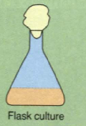
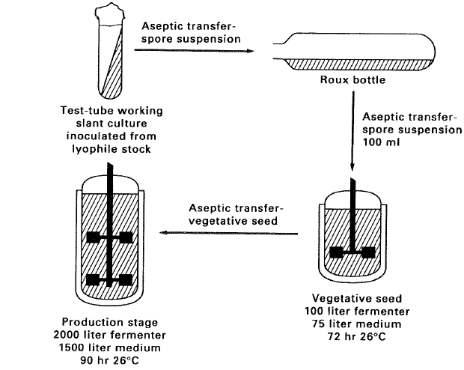

Slide 18
FERMENTATION PROCESS
Carried out in liquid cultures & in air lift fermenters.
The medium is inoculated with a suspension of spore of Penicillium chrysogenum from second submerged inoculation tank or seed culture tank..
The medium is constantly aerated and agitated, and the mold grows throughout as pellets.
O₂ is supply by passing air through the culture at the rate of 0.5 to 1.0 volume or air⁻¹/min.
Temperature & pH is check intermittently to control it.
After about seven days, growth is complete, the pH rises to 8.0 or above, and penicillin production ceases.
Fermentation broth is withdrawn & antibiotic is recovered.

Slide 19
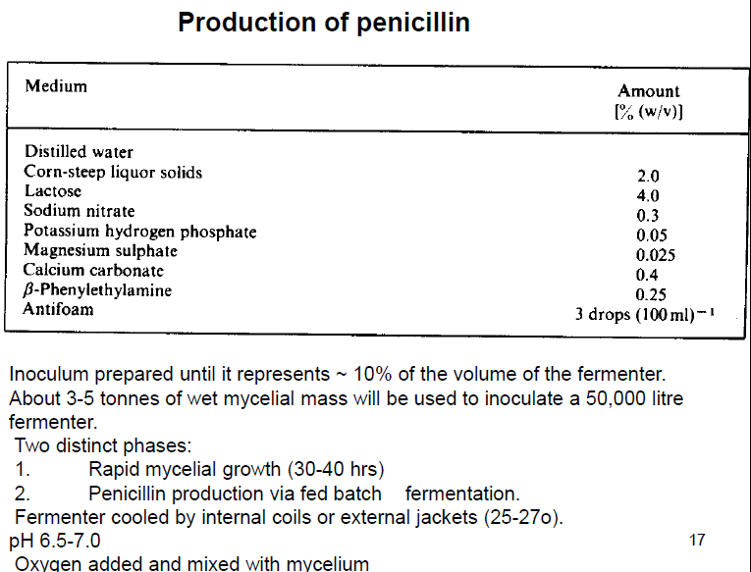

Slide 20
Fermentation condition
Aerobic process
pH: Near 6.5 throughout the production
Temp.: 23-28°C is desired

Slide 21
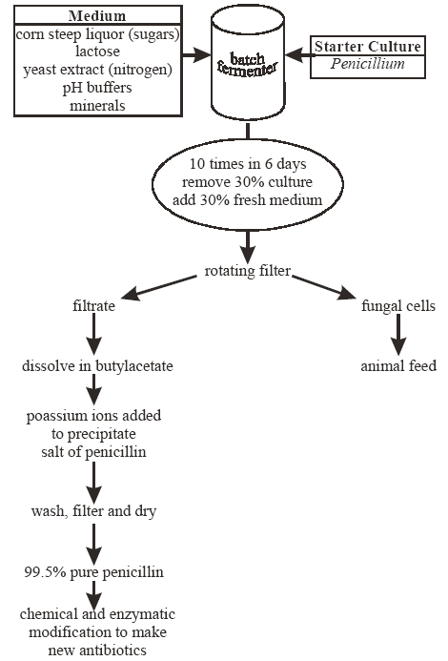

Slide 22
Penicillin Recovery
There are ten steps in the recovery of Penicillin:
1. Broth Filtration:The Rotary Vacuum Filter is the most common piece of equipment used for the
extraction of penicillin, and is used in continuous processing.
2. Filtrate Cooled:From filtration, the penicillin rich solution is cooled to 5°C. As penicillin G only has a half-life 15 minutes at pH 2 at 20°C, this helps reduce enzyme and chemical degradation during the solvent extraction step
3. Further Filtration:Resistance can be caused by the filter cloth, which also adds to the resistance of the filter cake as it accumulates. Pre-coats and filter aids can be used to assist the filtration.
4. Extraction of Penicillin with Solvent:Liquid-liquid extraction is suitable for the recovery of penicillin because of its operation at low temperatures, greater selectivity and is less expensive compared to distillation, evaporation and membrane technology. Penicillin is extracted from an aqueous phase into the solvent butyl acetate or
amyl acetate. When working with penicillin the lower the pH, the greater the K value, thus making
extraction more efficient. Sulphuric or phosphoric acid is added to created pH 2.5-3.0.

Slide 23
5. Carbon Treatment:Our penicillin rich solution is then treated with 0.25-5% activated carbon to remove pigments and impurities. Activated carbon is an amorphous solid, and absorbs molecules from the liquid phase through is highly developed internal pore structure. It is obtained in powered, pelleted or granular form and is produced from coal, wood and coconut shells.
6. Transfer back to Aqueous Phase:the penicillin rich solvent is
passed into a fresh aqueous phase. This is done in the presence of Potassium or Sodium
Hydroxide to bring the pH back to 5.0-7.5, creating the penicillin salt.
7. Solvent Recovery:The penicillin solvent is usually recovered by distillation. Distillation is carried out in three phases: Evaporation, Vapour-liquid separation in a column and condensation of the vapour.
Firstly the solvent is vaporised from the solution, then the low boiling volatile components are separated from the less volatile components in a column, and finally condensation is used to recover the volatile solvent fraction. Solvent recovery is an important process, as solvent is a major expense in the penicillin extraction process.
8. Crystallisation:Batch crystallisation is the most the most used method for polishing antibiotics,
including penicillin G. Batch crystallisers simply consist of tanks with stirrers and are
sometimes baffled. They are slowly cooled to produce supersaturation. Seeding causes
nucleation and growth is encouraged by further cooling until the desired crystals are
obtained.
9. Crystal Washing
10. Drying of Crystals

Slide 24
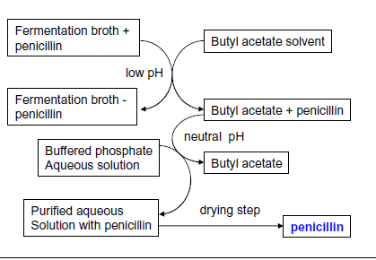

Slide 25
Downstream Processing:
Purification Of Benzyl Penicillin
Harvest broth from the fermenter
Chill it to 5-10°C.
Filter the broth to remove mycelium of fungus using rotary vacumm filter.
The filtarte is acidified to low pH. The pH is adjusted to 2-2.5 with the help of phosphoric or sulphuric acids.
butyl acetate is added to extract penicillin from aqueous filtrate.
This step has to be carried out quickly for penicillin is very unstable at low pH values.
Antibiotic is then extracted back into an aqueous buffer at a pH of 7.5, the partition coefficient now being strongly in favor of the aqueous phase. The resulting aqueous solution is again acidified & re-extracted with an organic solvent.

Slide 26
Downstream Processing:
Purification Of Benzyl Penicillin
These shifts between the water and solvent help in the purification of penicillin.
The treatment of the crude penicillin extract varies according to the objective, but involves the formation of an appropriate penicillin salt.
The solvent extract recovered in the previous stage is carefully extracted back with aqueous sodium hydroxide.
This is followed by charcoal treatment to eliminate pyrogens and by sterilization.
Pure metal salts of penicillin can be safely sterilized by dry heat, if desired. Thereafter, the aqueous solution of penicillin is subjected to crystallization.

Slide 28
Further processing
For parental use, the antibiotic is packed in sterile vials as a powder or suspension.
For oral use, it is tabletted usually now with a film coating.
Searching tests (ex: for purity, potency) are performed on the appreciable number of random samples of the finished product.

Slide 29
